Slide 1
Visualisation d’information
Perception, cognition et design

Slide 2
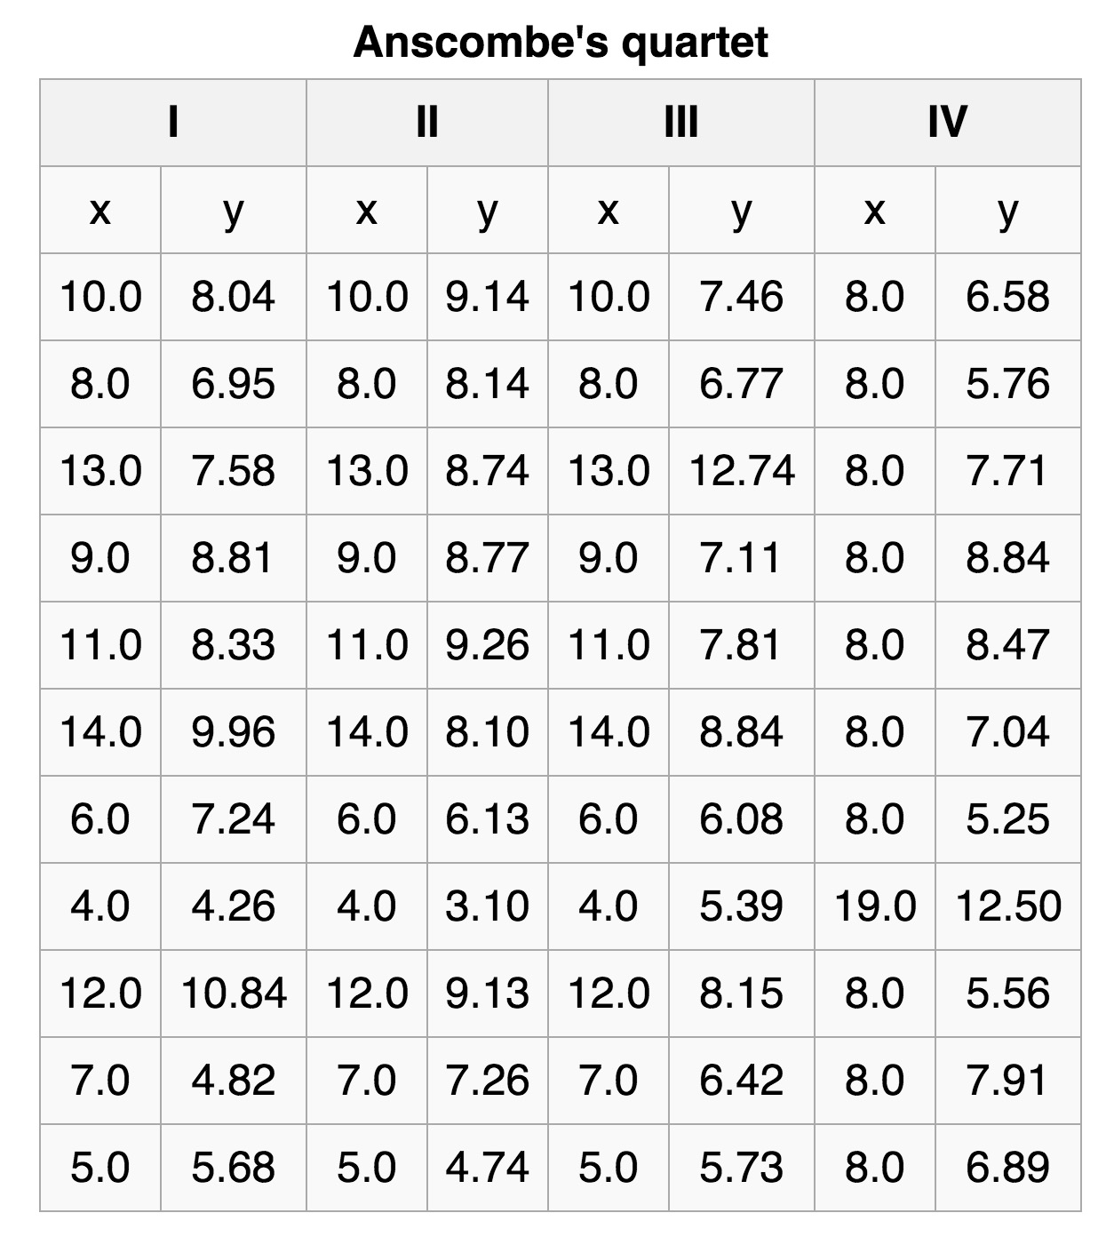
Why visualize?
https://en.wikipedia.org/wiki/Anscombe%27s_quartet

Slide 3
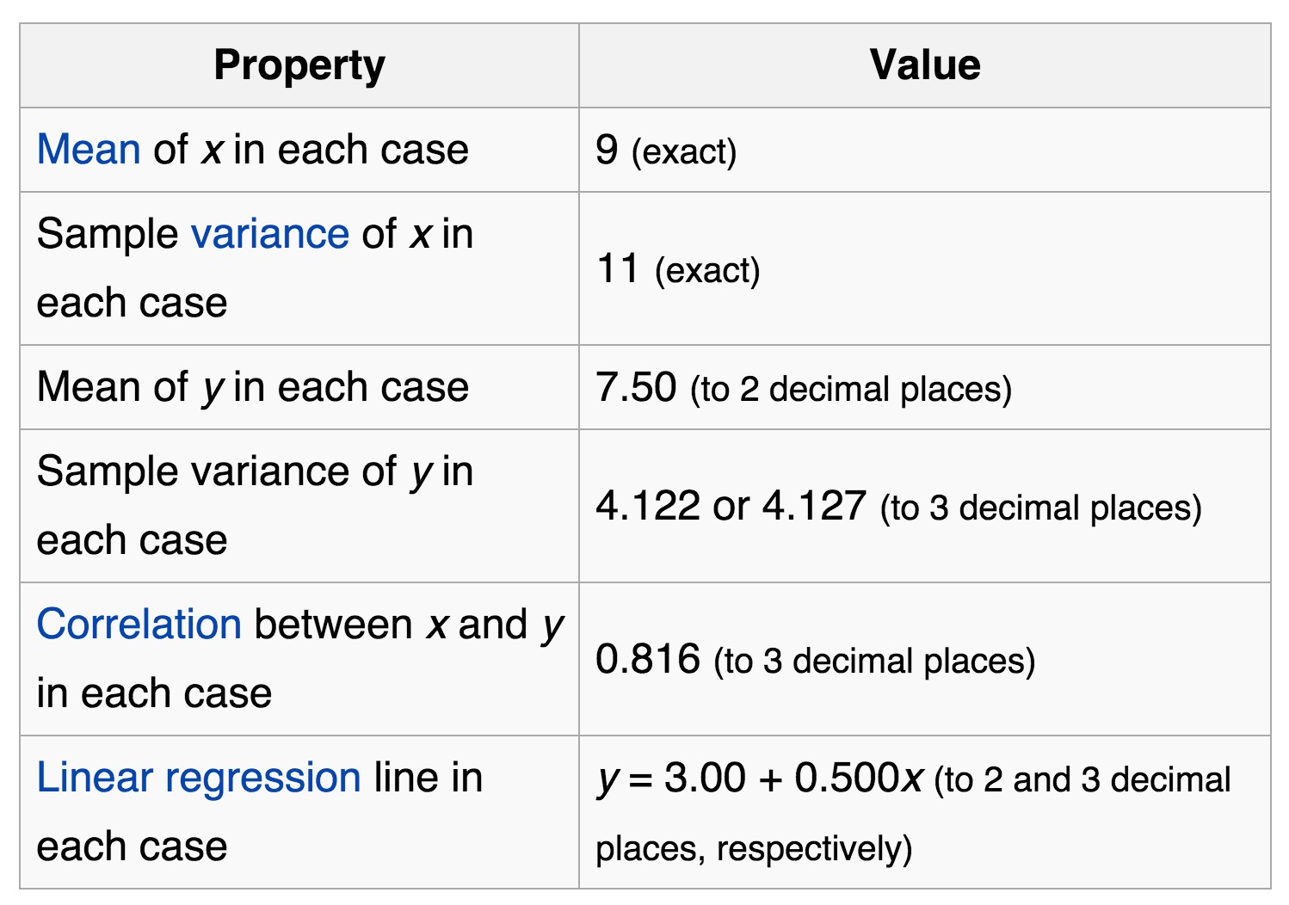
Why visualize?

Slide 4
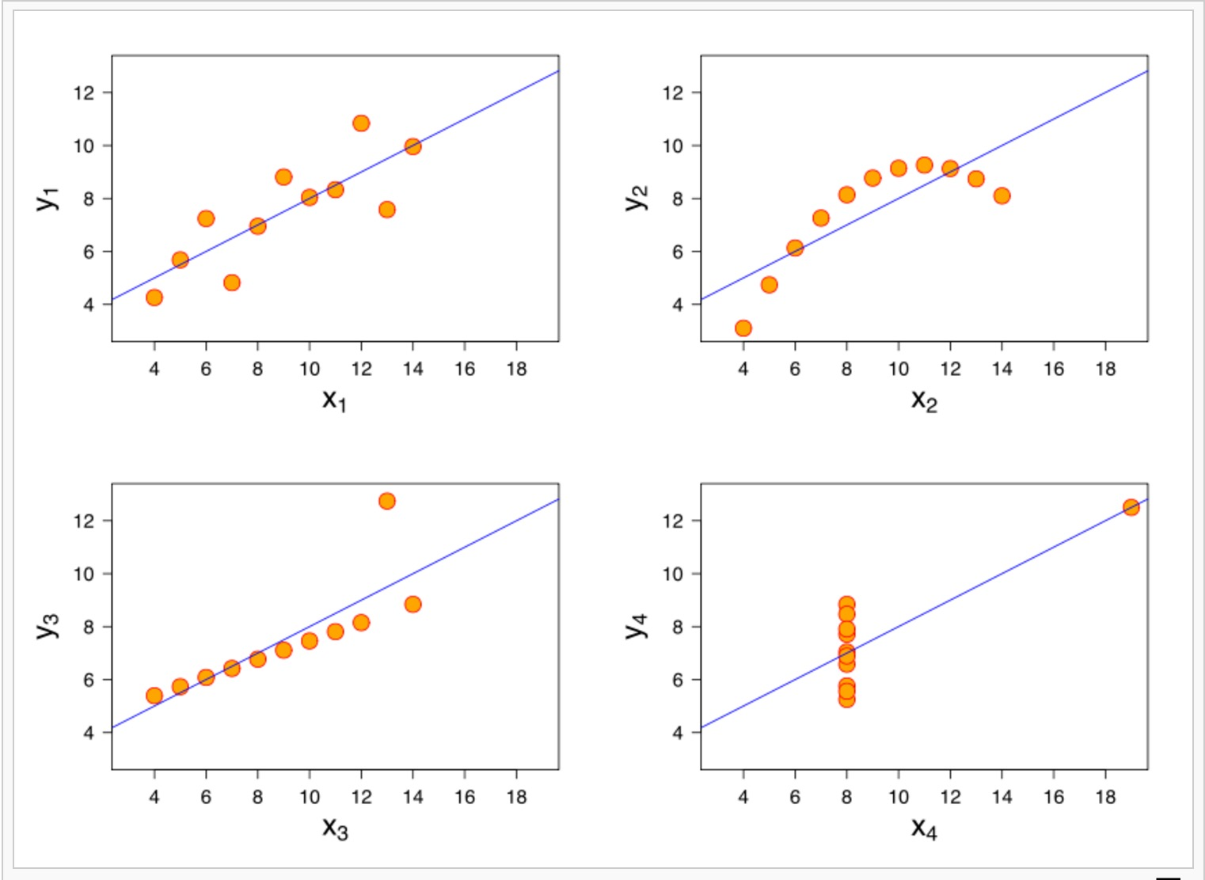
Why visualize?

Slide 5
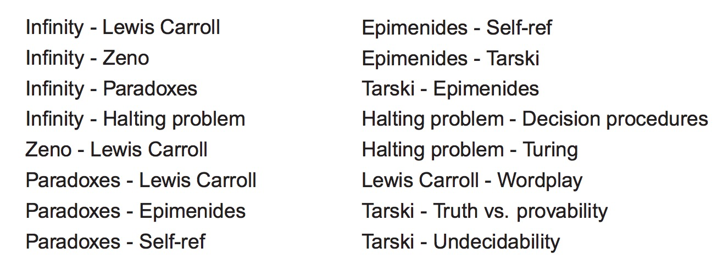
Traitement de l’information
Notes:
Traitement visuel d’une liste – relationships

Slide 6
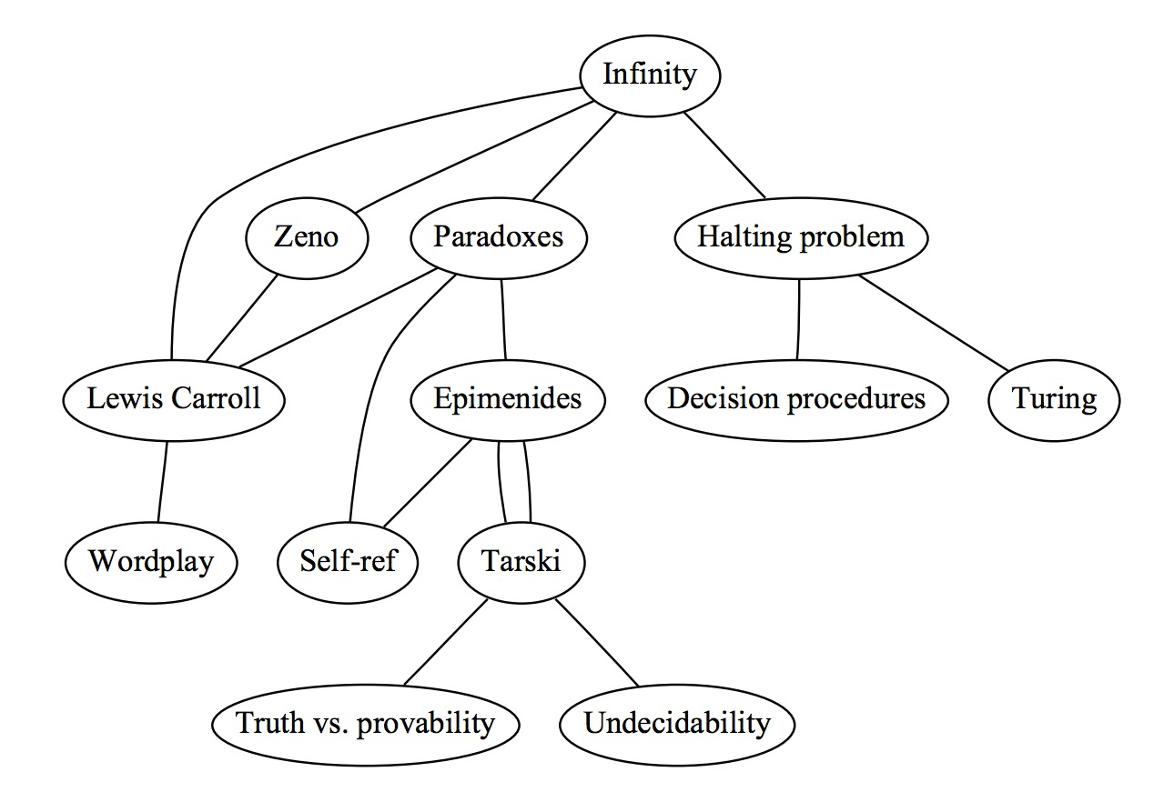
Traitement de l’information
Notes:
Code visuel: tirer profit des capacités de traitement visuel

Slide 7
Système de visualisation d’info - contraintes
Computationnelle
Fluidité
Complexité algorithmique
Perception et cognition (humain)
Mémoire et attention limitée
Dispositif physique (écran)
Information density (Tufte)

Slide 8
Visualisation d’information
Perception, cognition
Design - Règles et bonnes pratiques
Variables visuelles
Interactions

Slide 9
Perception

Slide 10
Perception et cognition
Perception
Physiology
Pre-attentive processing
Cognition (humain)
Gestalt principles
Mémoire et attention limitée

Slide 11
Perception – Illusion d’optique
Physiology
Virtual objects
Visual distorsion
Shape distorsion

Slide 12
Perception – Virtual objects
In or Out?

Slide 13
Perception – Virtual objects
Do the lines actually exist?

Slide 14
Perception – Virtual objects
Do the white arrows exist?

Slide 15
Perception – Virtual objects
Is the square really there?

Slide 16
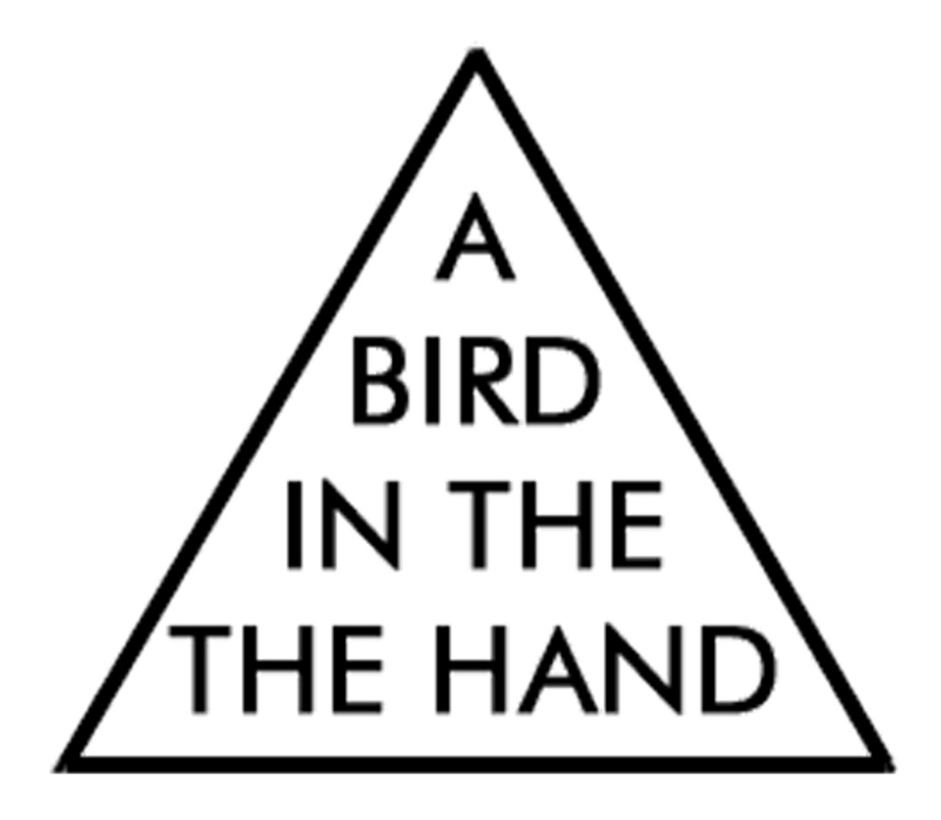
Perception – Visual Distorsion
Notes:
Lire à voix haute

Slide 17
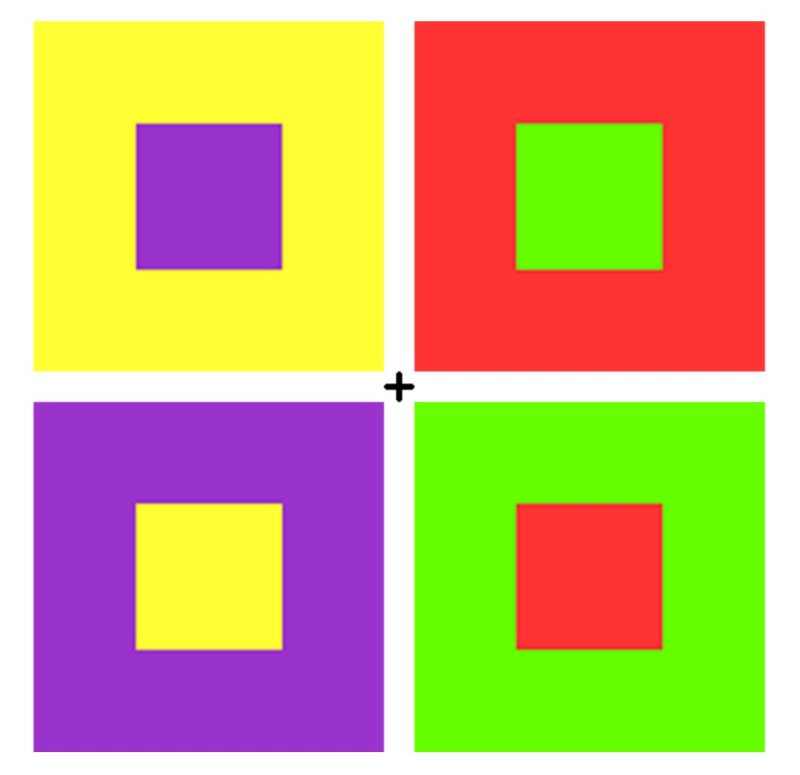
Perception – Impression rétinienne

Slide 18
Perception – Visual Distorsion
Grey Diagonals

Slide 19
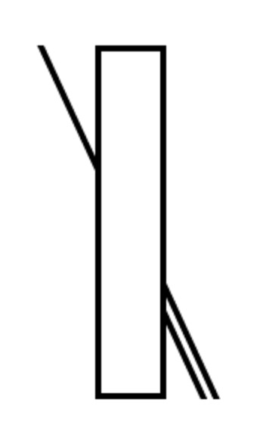
Perception – Visual Distorsion
Which line continues the straw?

Slide 20
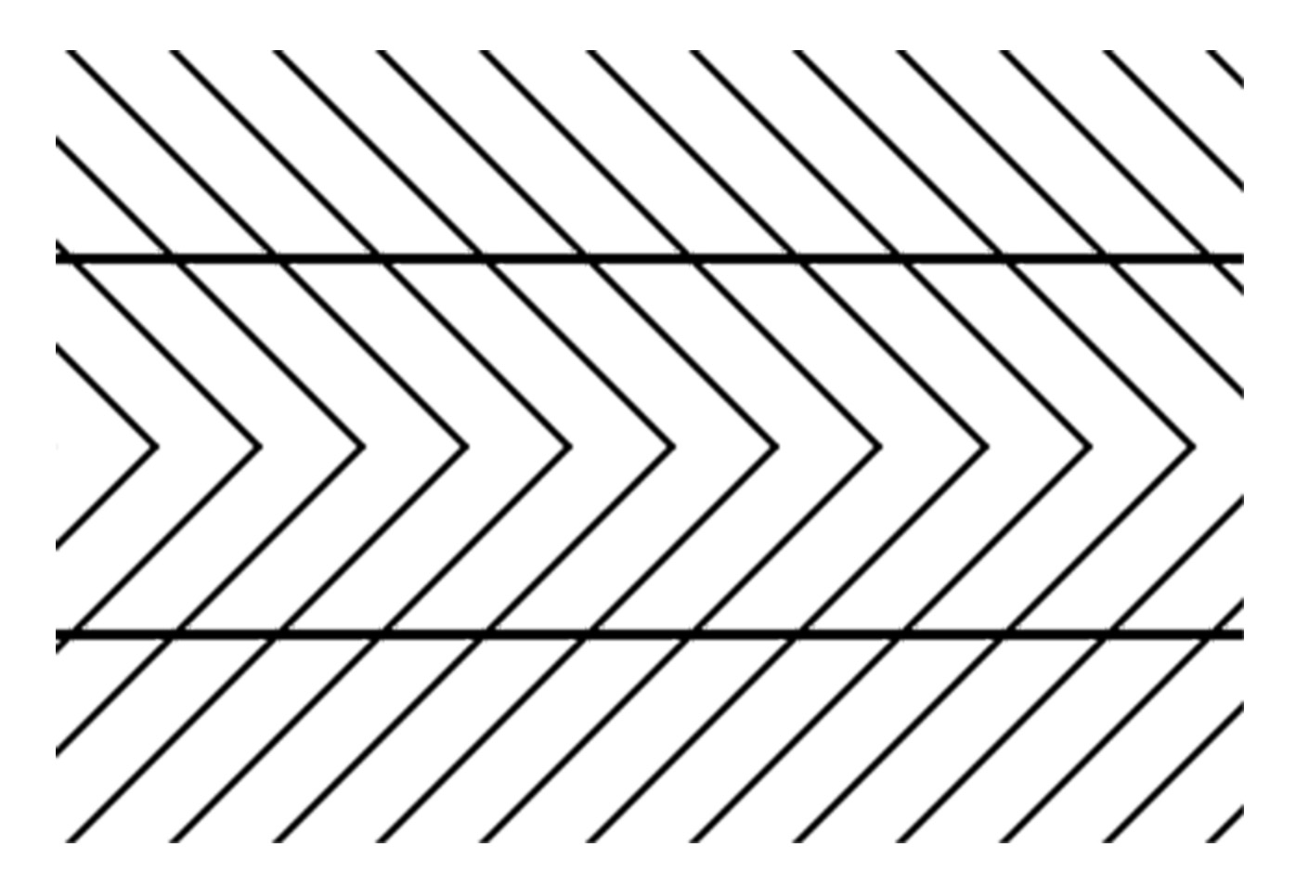
Perception – Shape Distorsion
Are these lines parallel?

Slide 21
Perception – Shape Distorsion
Slow rotation

Slide 22
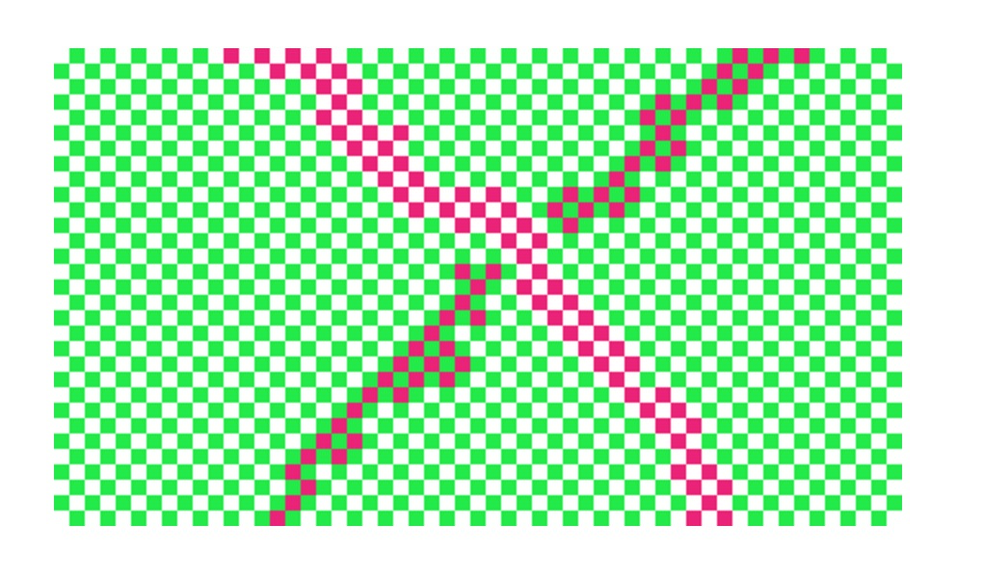
Perception – Color contrast
How many colors?

Slide 23
Perception – Color contrast
Uniform grey?

Slide 24
Perception – Color contrast
Same color square

Slide 25
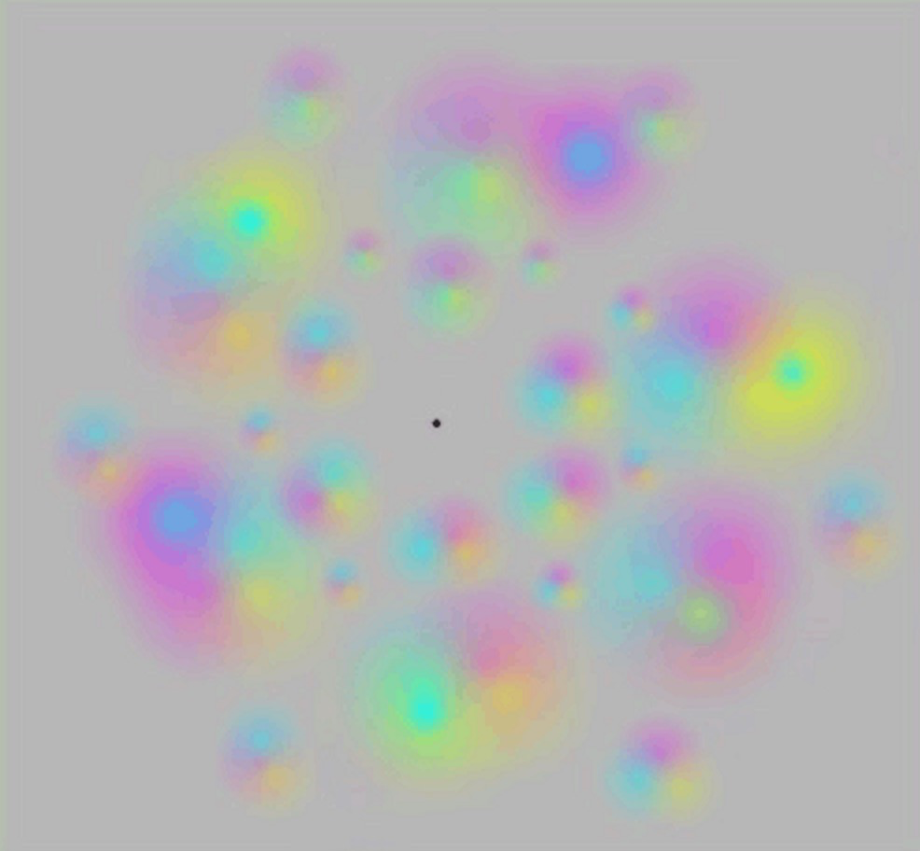
Perception – Color contrast
Colours eventually disappears

Slide 26
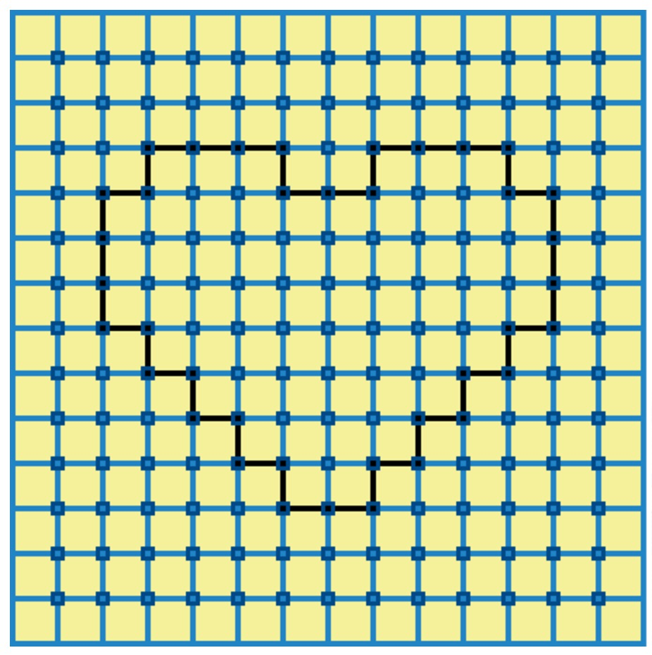
Perception – Color contrast
Orange heart

Slide 27
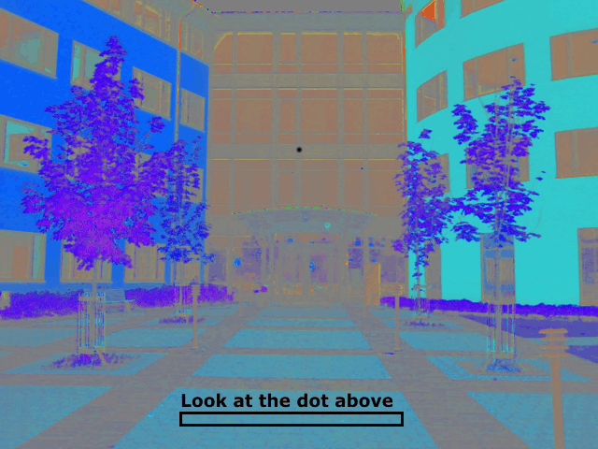
Perception – Color contrast
Color or black & white?

Slide 28
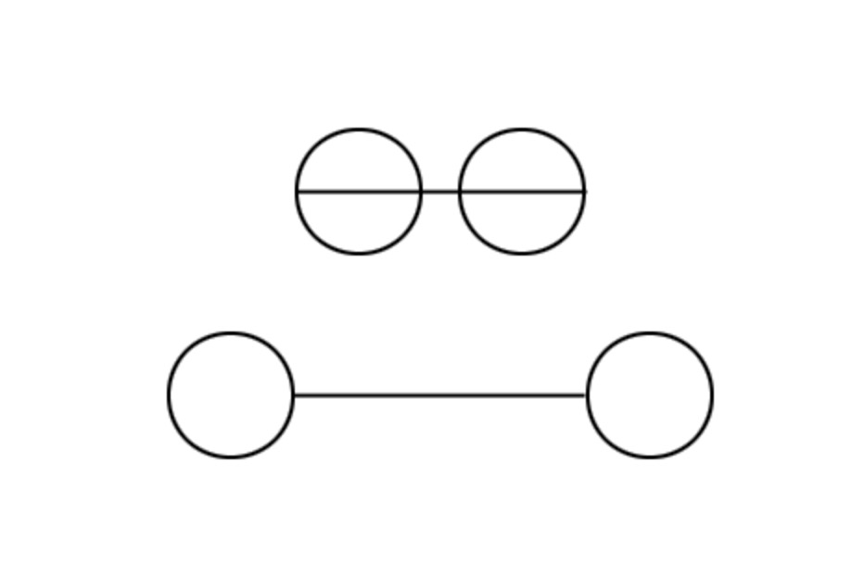
Perception – Size Distorsion
Which line is longer?

Slide 29
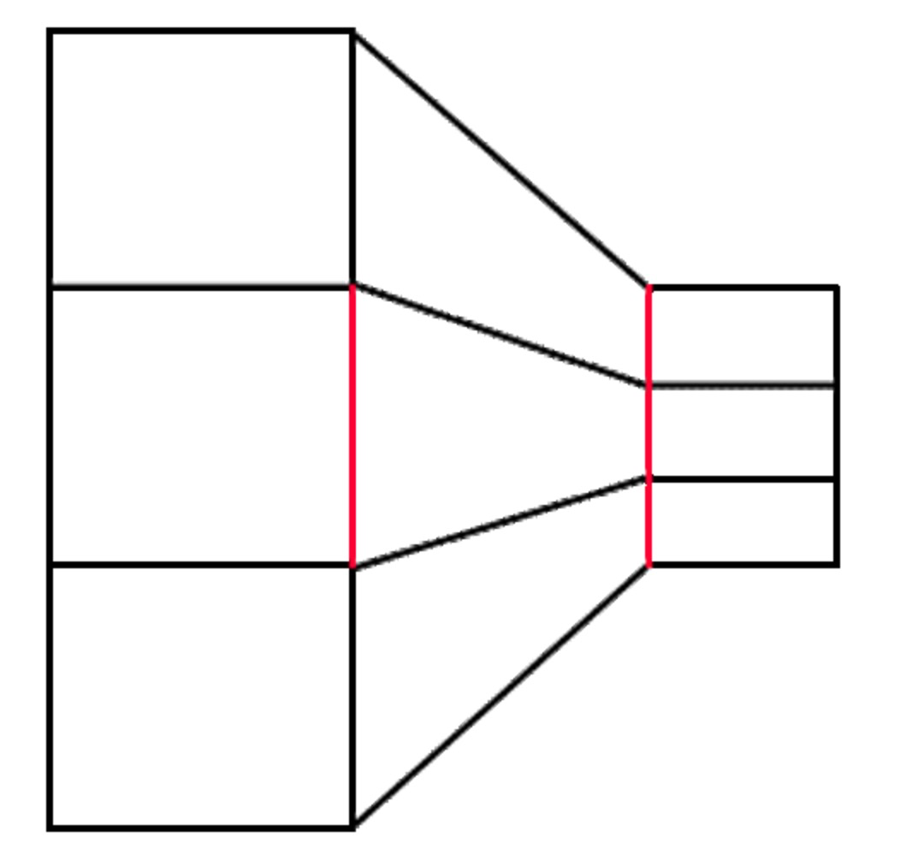
Perception – Size Distorsion
Same length (red lines)?

Slide 30
Perception – Size Distorsion
Same size?

Slide 31
Pre-attentive processing

Slide 32
Perception – Pre-attentive processing
< 200 - 250ms qualifies as pre-attentive
eye movements take at least 200ms
can be done very quickly
low-level processing in parallel

Slide 33
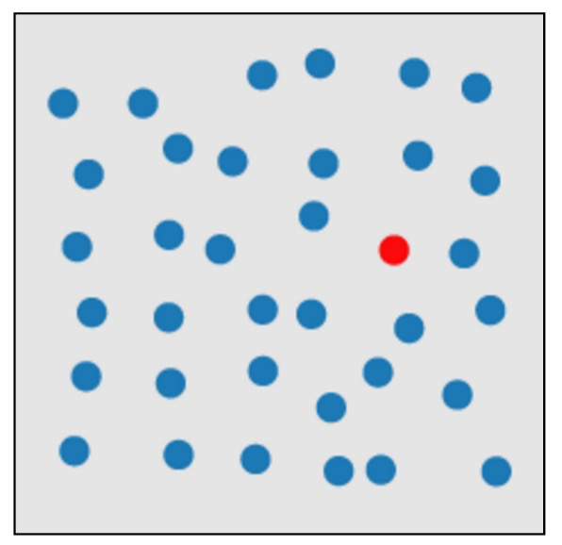
Perception – Pre-attentive processing

Slide 34
Perception – Pre-attentive processing
Healey video

Slide 35
Perception – Pre-attentive processing
Target
has a unique feature

Slide 36
Perception – Pre-attentive processing
Target
does not have a unique feature

Slide 37
Perception – Pre-attentive processing
SUBJECT PUNCHED QUICKLY OXIDIZED TCEJBUS DEHCNUP YLKCIUQ DEZIDIXO
CERTAIN QUICKLY PUNCHED METHODS NIATREC YLKCIUQ DEHCNUP SDOHTEM
SCIENCE ENGLISH RECORDS COLUMNS ECNEICS HSILGNE SDROCER SNMULOC
GOVERNS PRECISE EXAMPLE MERCURY SNREVOG ESICERP ELPMAXE YRUCREM
CERTAIN QUICKLY PUNCHED METHODS NIATREC YLKCIUQ DEHCNUP SDOHTEM
GOVERNS PRECISE EXAMPLE MERCURY SNREVOG ESICERP ELPMAXE YRUCREM
SCIENCE ENGLISH RECORDS COLUMNS ECNEICS HSILGNE SDROCER SNMULOC
SUBJECT PUNCHED QUICKLY OXIDIZED TCEJBUS DEHCNUP YLKCIUQ DEZIDIXO
CERTAIN QUICKLY PUNCHED METHODS NIATREC YLKCIUQ DEHCNUP SDOHTEM
SCIENCE ENGLISH RECORDS COLUMNS ECNEICS HSILGNE SDROCER SNMULOC
Text not pre-attentive

Slide 38
gestalt, mémoire et attention

Slide 39
Perception et cognition
Perception
Physiology
Pre-attentive processing
Cognition (humain)
Mémoire et attention limitée
Gestalt principles

Slide 40
Cognition - Change blindness
Daniel Simons and Daniel Levin (1997)
Movie perception test
Change in static image

Slide 41
Cognition - Change blindness
Daniel Simons and Daniel Levin (1997)
Movie perception test
Change in static image

Slide 42
Cognition – Gestalt principles
Why do patterns emerge?
Under what circumstances?
Idea: forms or patterns transcend the stimuli used to create them
« Le tout est plus que la somme des parties »

Slide 43
Cognition – Gestalt principles
Proximity

Slide 44
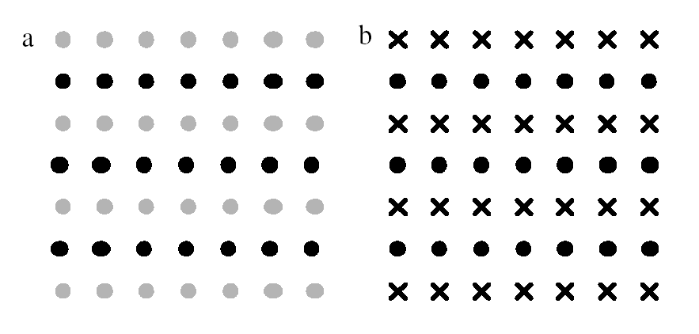
Cognition – Gestalt principles
Similarity

Slide 45
Cognition – Gestalt principles
Law of common fate

Slide 46
Cognition – Gestalt principles
Continuity

Slide 47
Cognition – Gestalt principles
Continuity

Slide 48
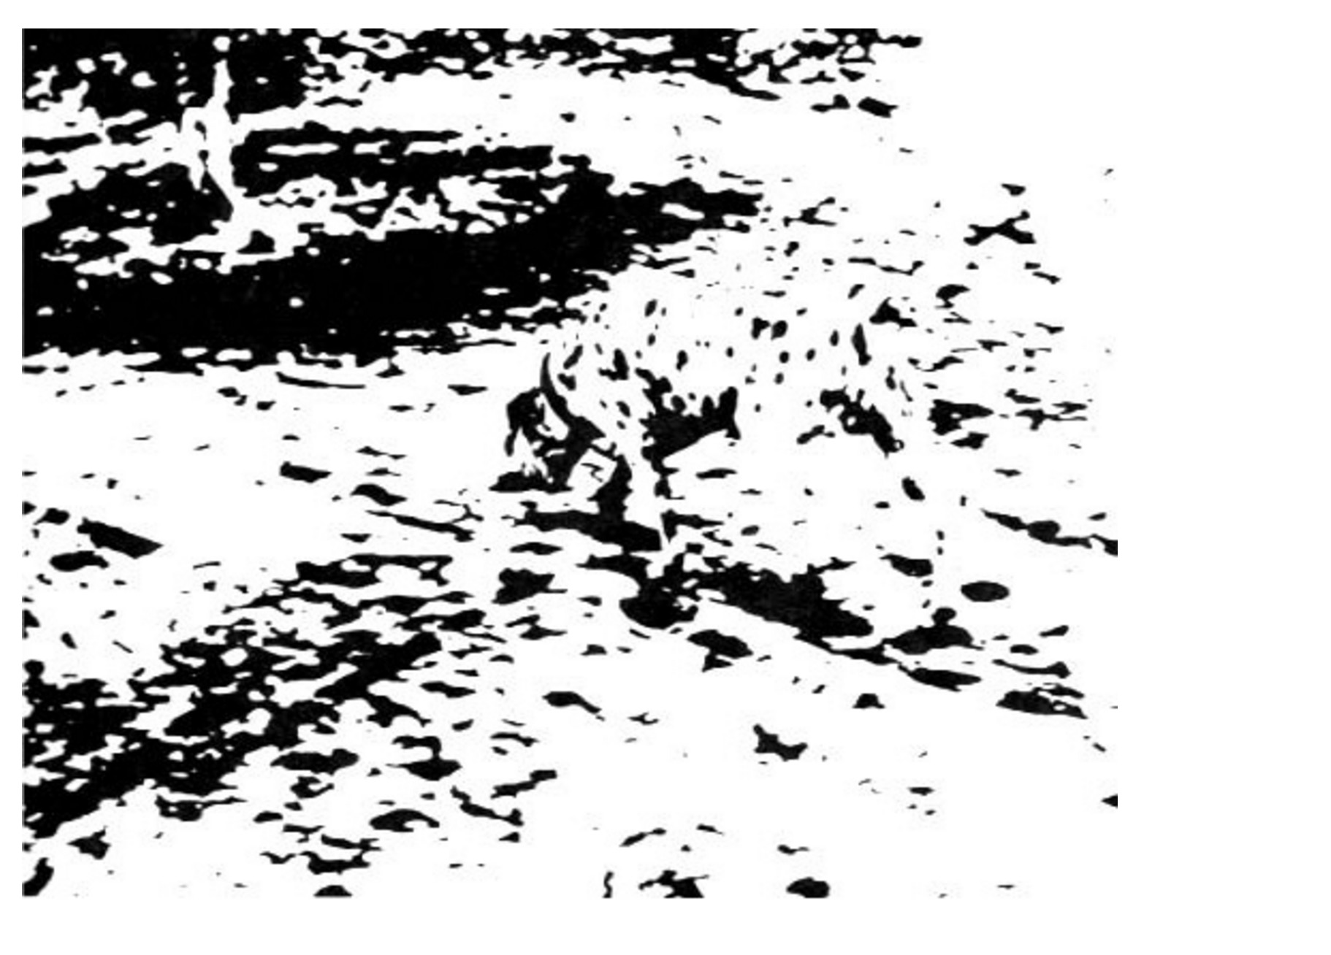
Cognition – Gestalt principles
Emergence

Slide 49
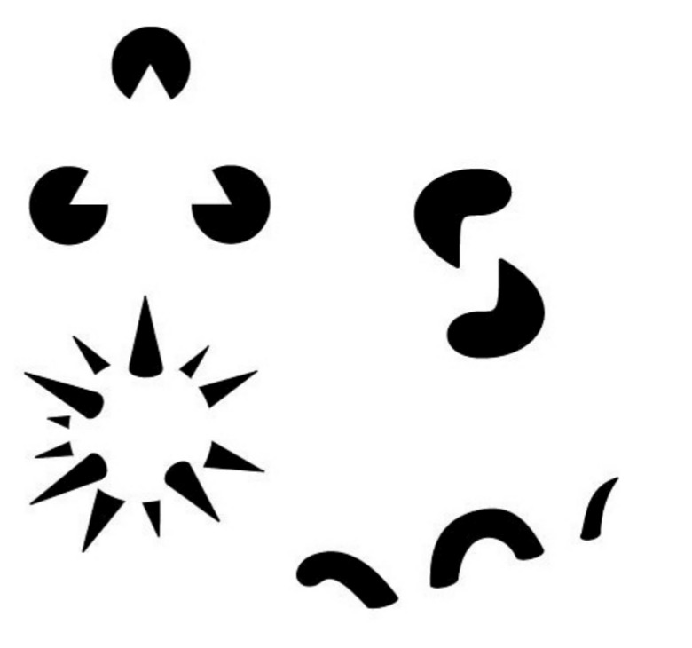
Cognition – Gestalt principles
Reification

Slide 50
Cognition – Gestalt principles
Closure

Slide 51
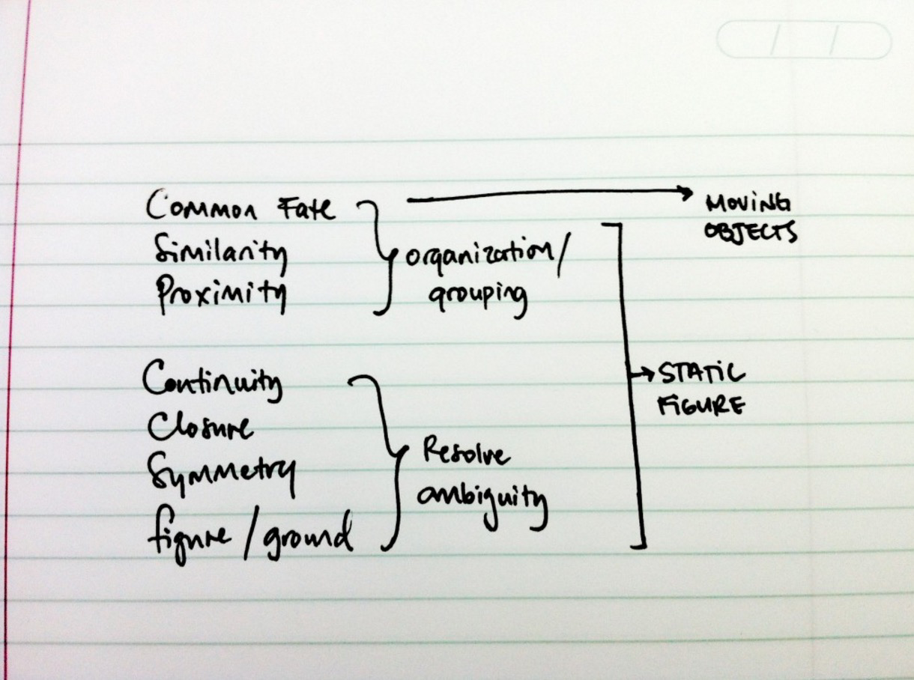
Cognition – Gestalt principles

Slide 52
sémiotique: grammaire de la cartographie

Slide 53
« Grammaire visuelle »
Principes sémiotiques
Jacques Bertin (géographe)
Théorie de la communication
Distance opérationnelle (perception / physiologie)
Distance articulatoire (accessibilité)
Distance sémantique (interprétation, références culturelles)

Slide 54
« Grammaire visuelle »
Principes sémiotiques
Jacques Bertin (géographe)
Cartastrophe
Apprendre des mauvais exemples

Slide 55
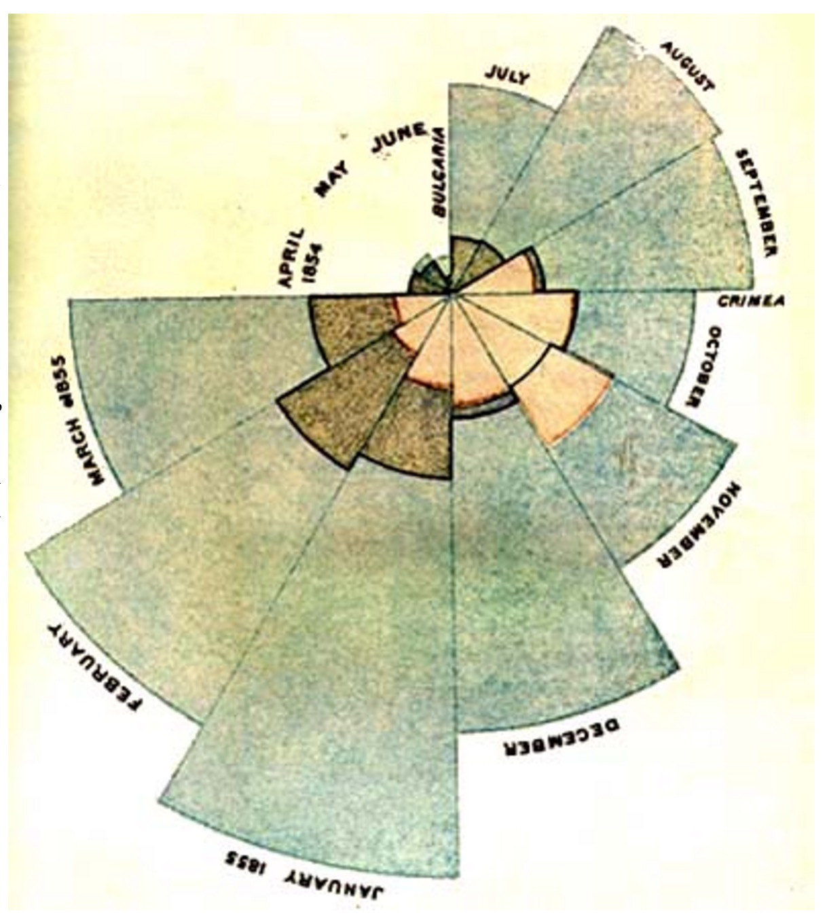
« Grammaire visuelle »
Principes sémiotiques
Florence Nightingale (1854)

Slide 56
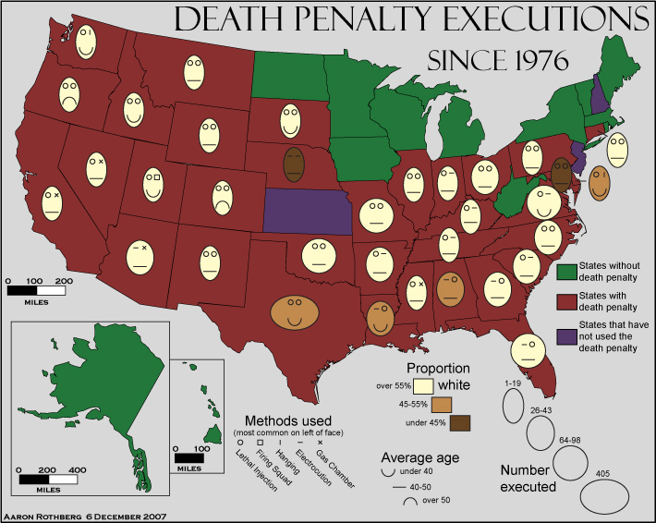
« Grammaire visuelle »
Cartastrophe
Death Penalty Executions

Slide 57
« Grammaire visuelle »
Cartastrophe
American English Dialect

Slide 58
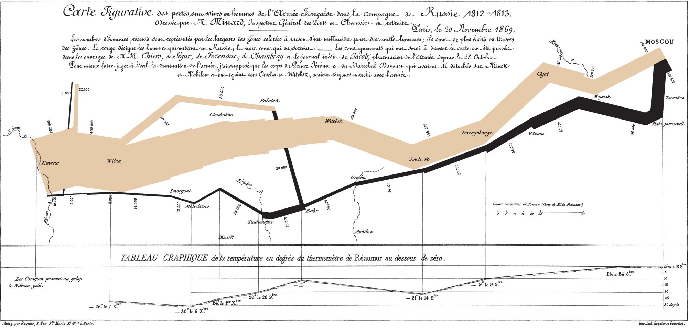
« Grammaire visuelle »
Principes sémiotiques
Apprendre des bons exemples: Minard (1869)

Slide 59
une science de la visualisation ?

Slide 60
Visualization Design
Règles et bonnes pratique
Variables visuelles
Données et tâches
Dashboard

Slide 61
Visualization Design
"Position is everything, color is difficult."
Moritz Stefaner

Slide 62
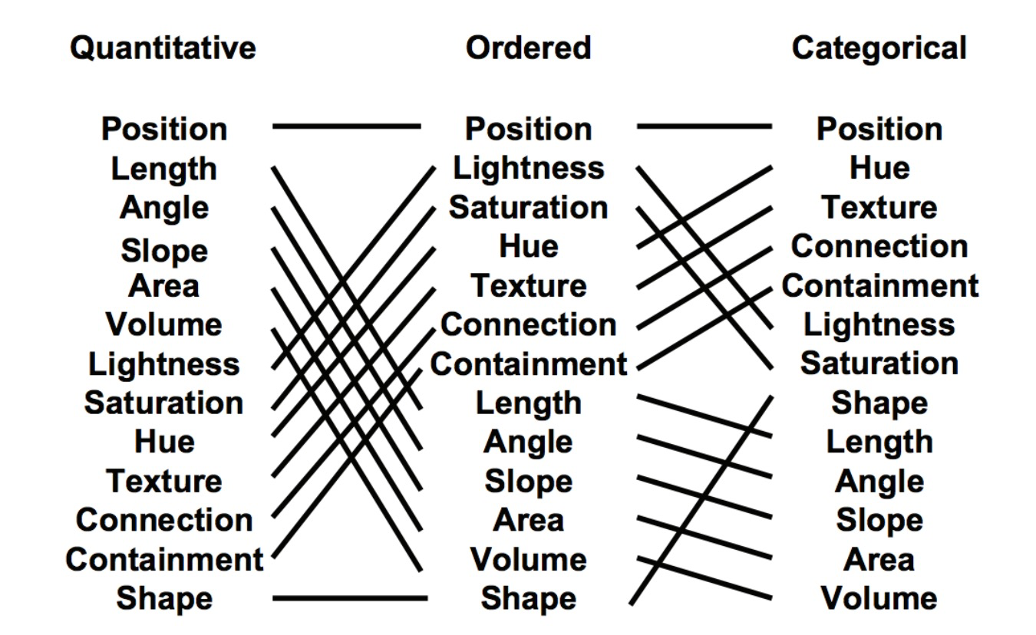
Visualization Design
MacKinley 1986

Slide 63
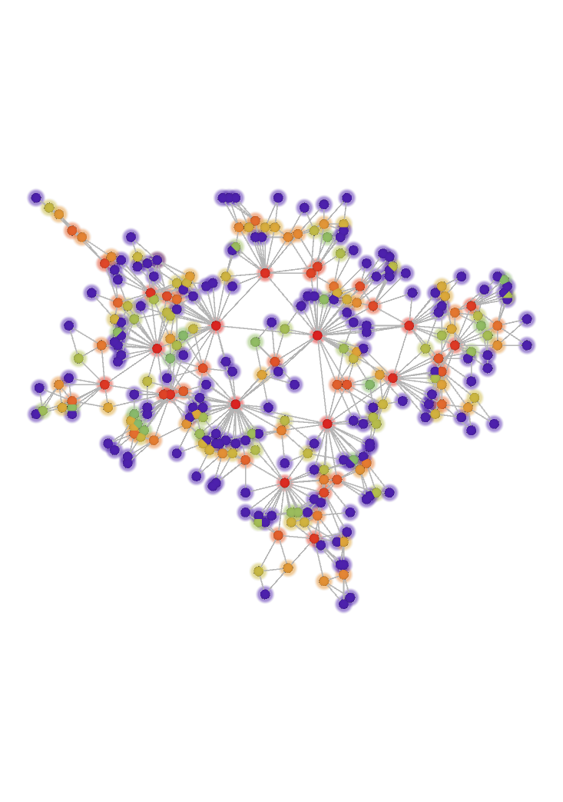
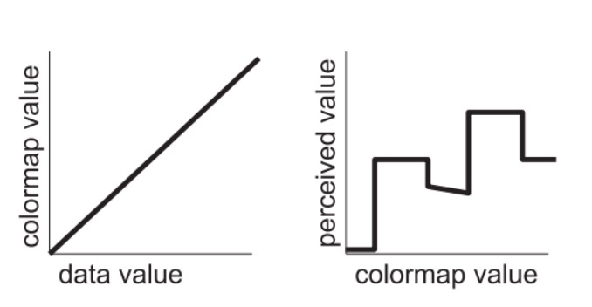
Visualization Design
Color is difficult
Rainbow colormap

Slide 64
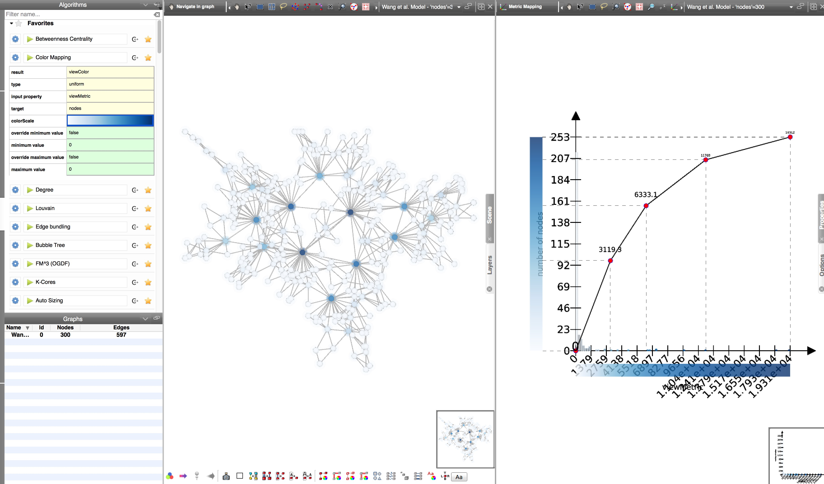
Visualization Design

Slide 65
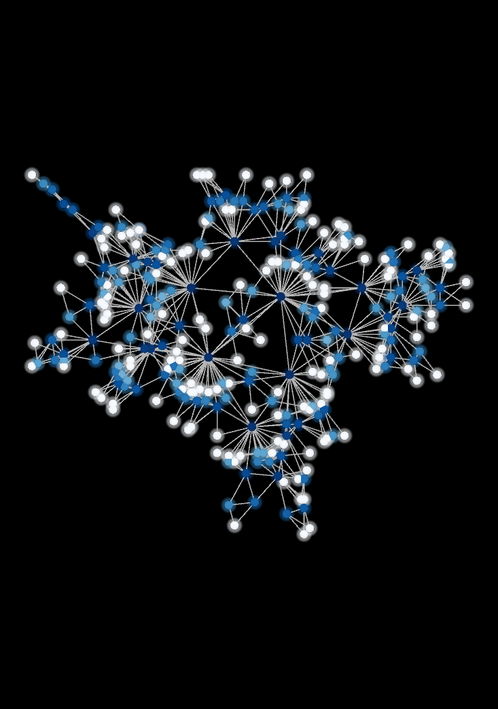
Visualization Design

Slide 66
Visualization Design
Choix des couleurs
ColorBrewer

Slide 67
Visualization Design
Shneiderman mantra
Overview First,
Zoom and Filter,
Details on Demand

Slide 68
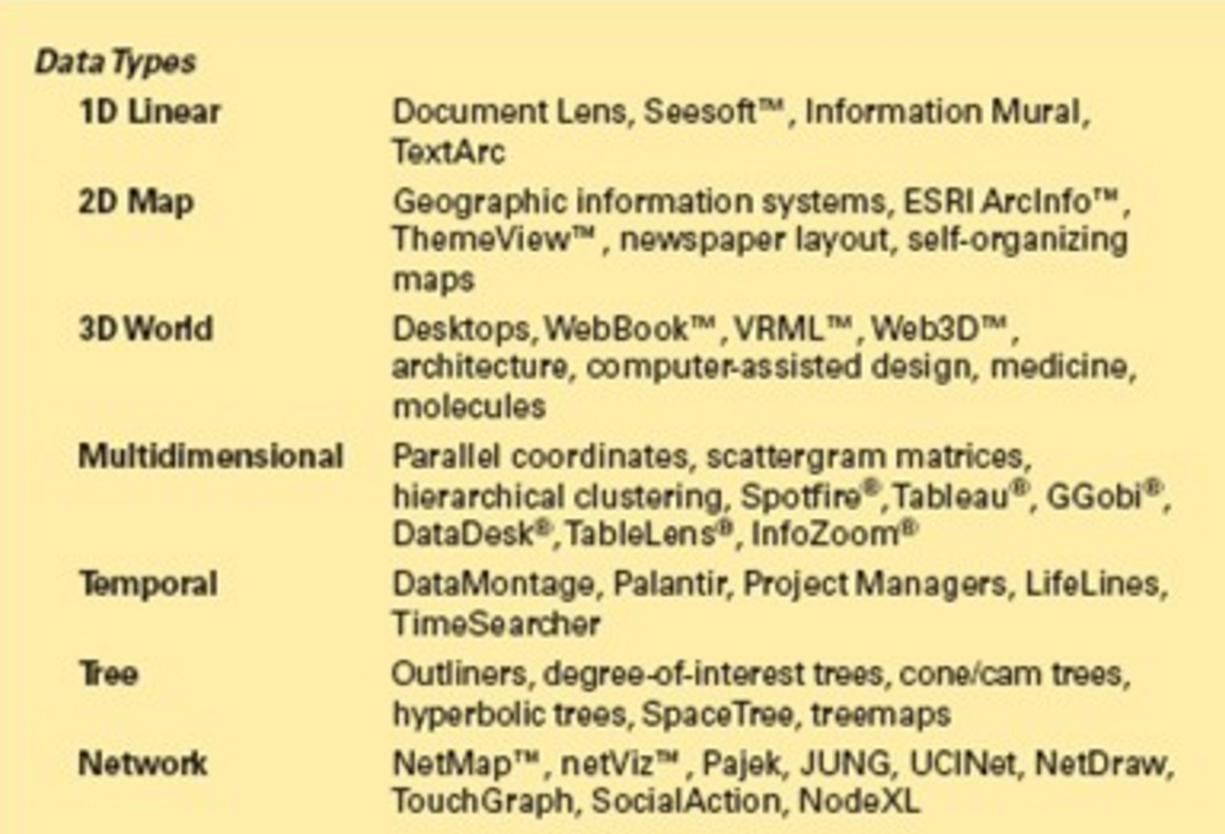
Shneiderman taxonomy

Slide 69
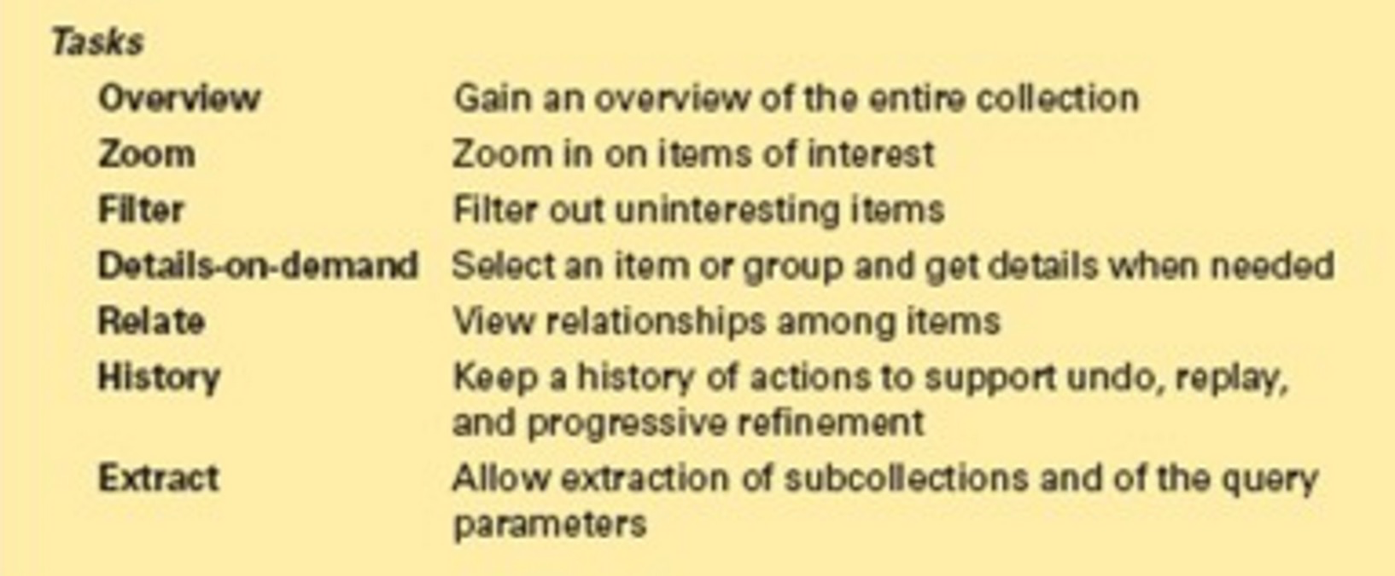
Shneiderman taxonomy
Overview First,
Zoom and Filter,
Details on Demand

Slide 70
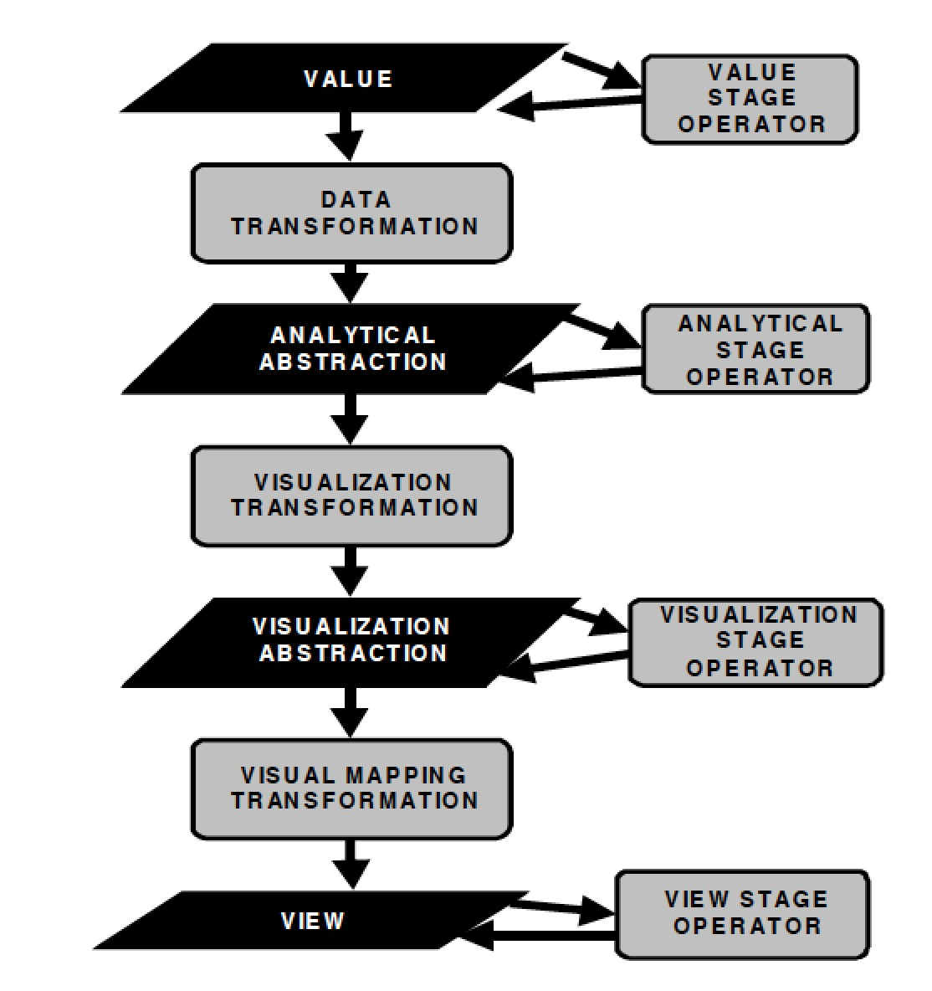
Visualization Design
Ed Chi Data State Reference Model

Slide 71
Visualization Design Interaction Principles
Overview
Reconfigure: show me a different arrangement
Encode: show me a different representation
Filter
show me something conditionally
Context-maintained Filter
Reduction Filter
Dynamic Queries
Brushing
Click-n-Drag
Explore: show me something else
Connect: show me related items
Abstract/Elaborate: show me more or less detail
Details-on-demand
Navigation
Navigation Box
Spatial Navigation
Select: mark something as interesting
Single Direct Selection
Multiple Direct Selection
Bounding Box
Single Direct Selection+Keyboard
Bounding Box+Keyboard

Slide 72
Visualization Design
Règles et bonnes pratique
Dashboard

Slide 73
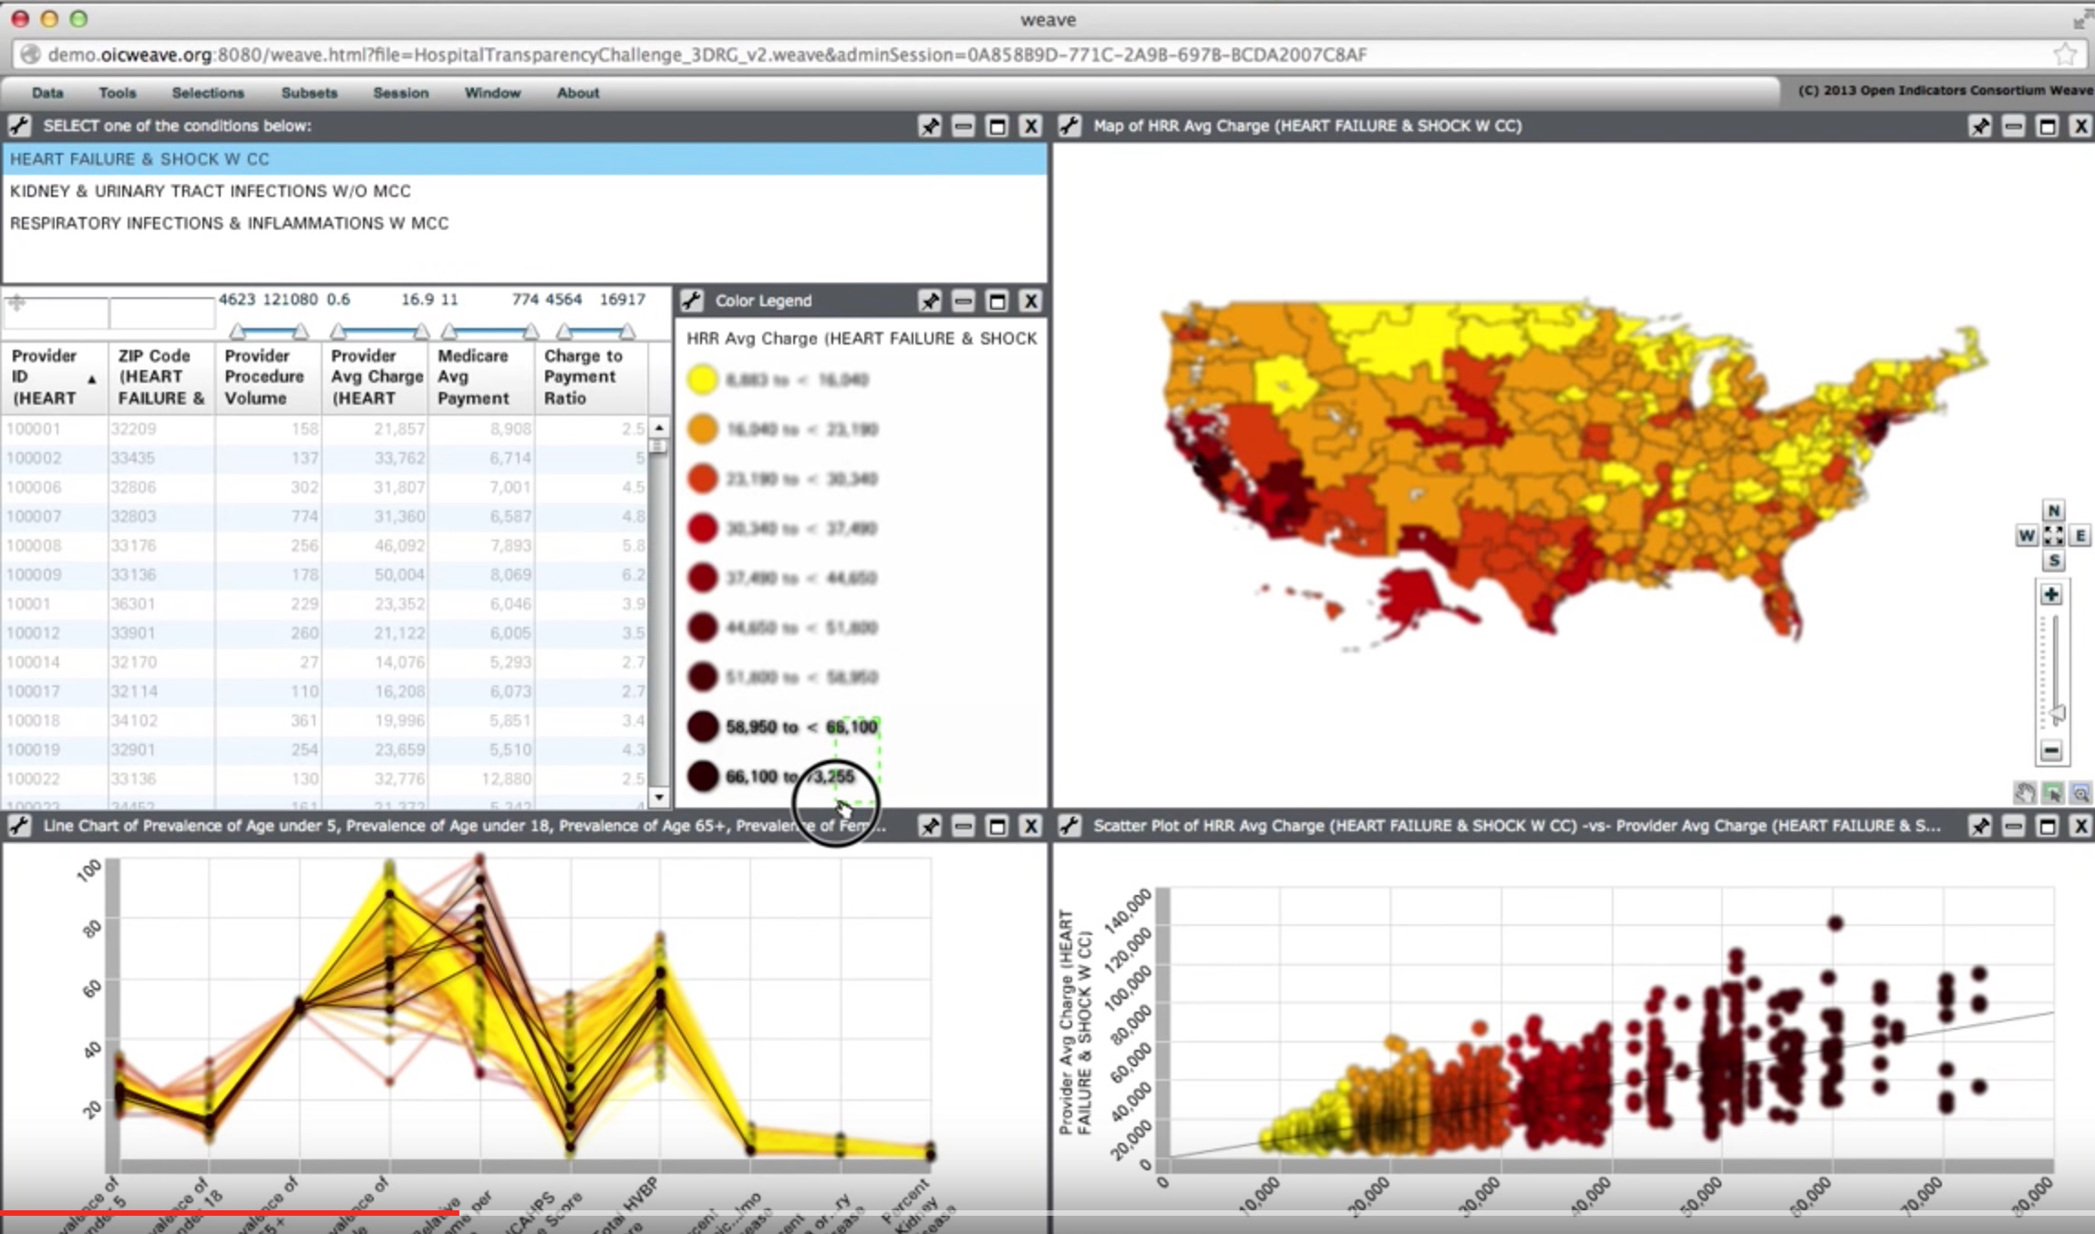
Visualization Design

Slide 74
Visual Dashboard - Le jeu des 13 erreurs
Exceeding the boundaries of a single screen
Choosing inappropriate display media
Using poorly designed display media
Supplying inadequate context for the data
Displaying excessive detail or precision
Highlighting important data ineffectively or not at all
Introducing meaningless variety
Choosing a deficient measure
Encoding quantitative data inaccurately
Misusing or overusing color
Arranging the data poorly
Designing an unattractive visual display
Cluttering the display with useless decoration
Stephen Few (2006)
Information Dashboard Design, O’Reilly

Slide 75
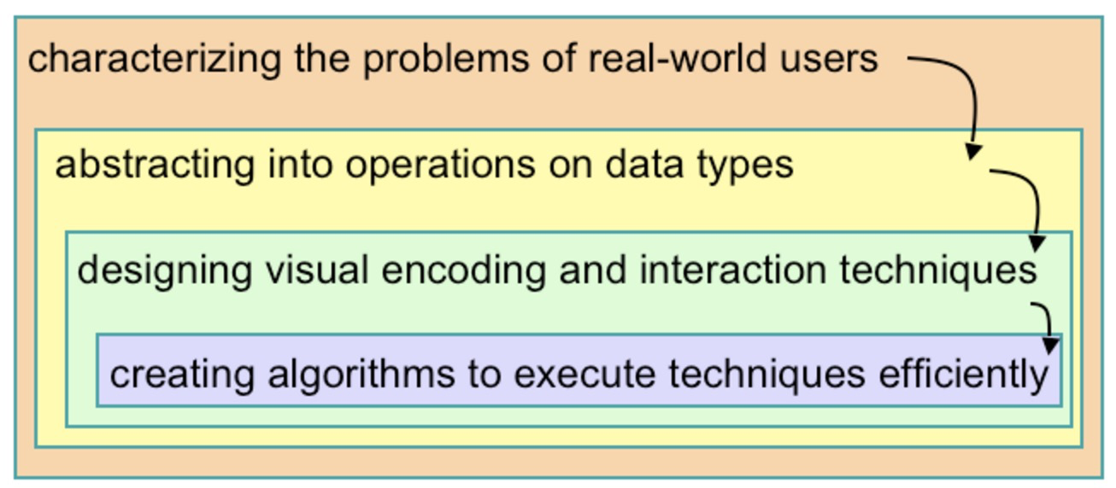
Visual Design Model

Slide 76
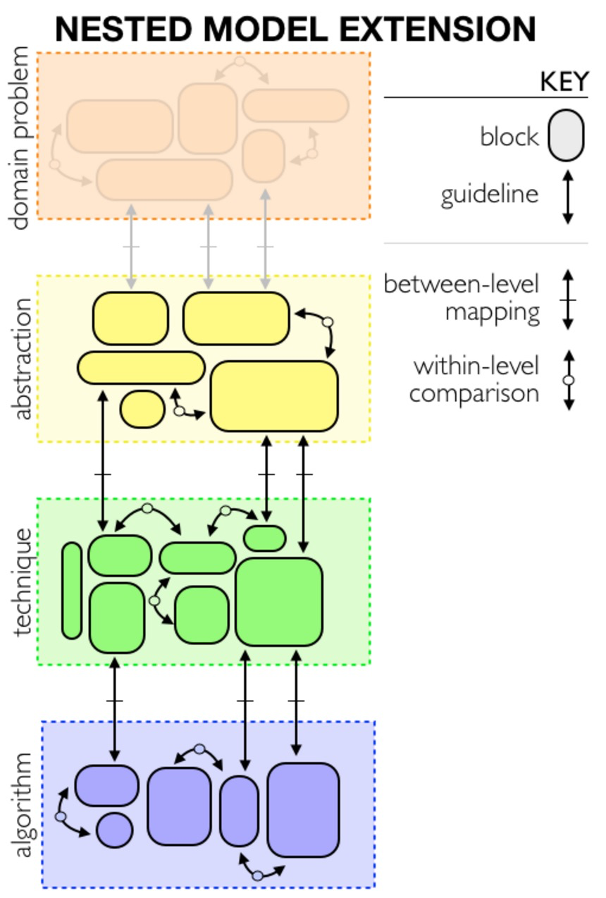
Visual Design Model

Slide 77
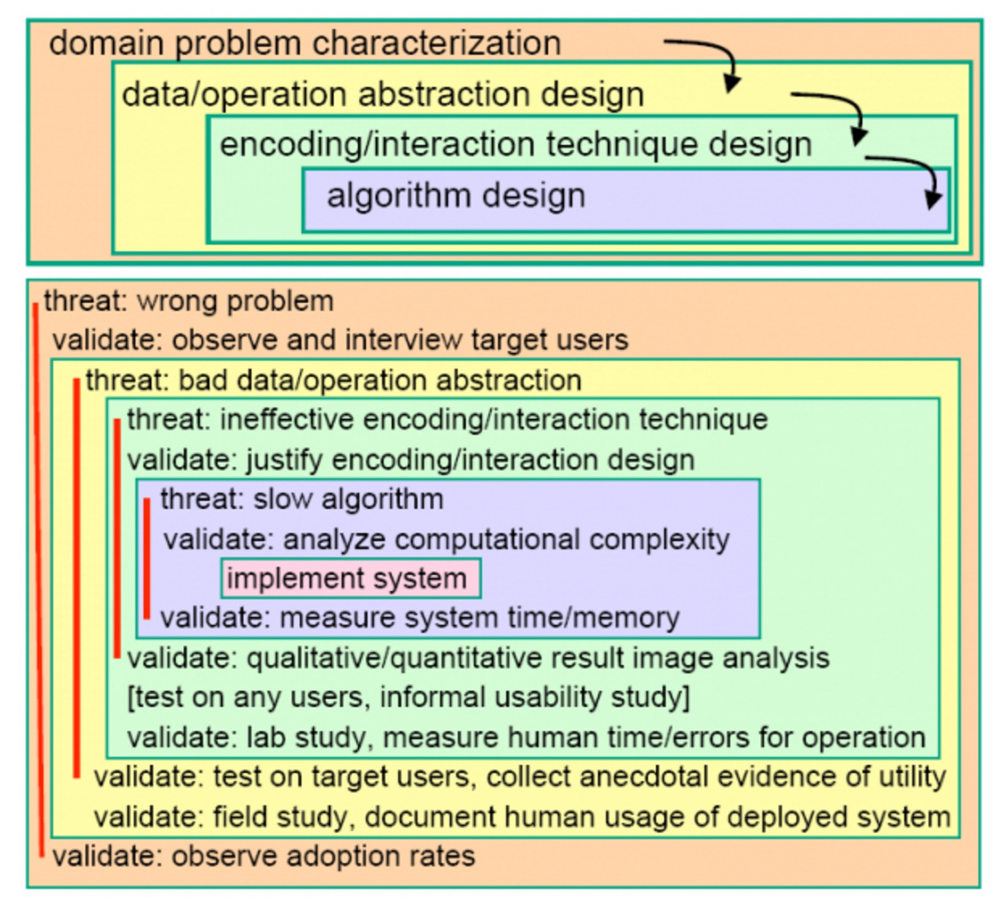
Visual Design Model
http://www.labri.fr/perso/melancon/Visual_Analytics_Course/doku.php?id=introduction

