Slide 1
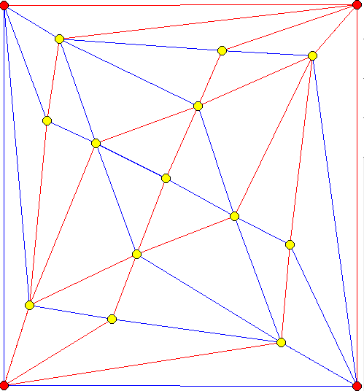
Which combinatorial triangulations can be realized as an L∞-Delaunay triangulation?
Nicolas Bonichon (Bordeaux U. – Inria CEPAGE-LaBRI)
Jit Bose (Carleton U.)
Sander Verdonschot (Carleton U.)
Work in progress
Acknowledgment: LIRCO; ANR JCJC EGOS

Slide 2
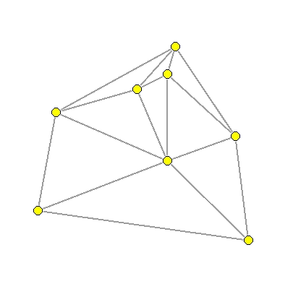
Combinatorial Triangulation
Planar map: planar graph embedded on the sphere with no edge crossings, up to continuous deformation.
Rooted: one edge is oriented. The face on its right is the outerface.
Triangulation: each inner face is a triangle.
=
≠

Slide 3
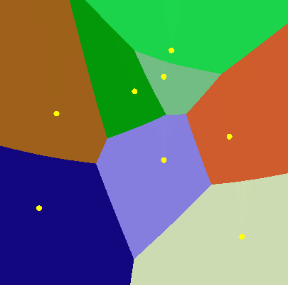
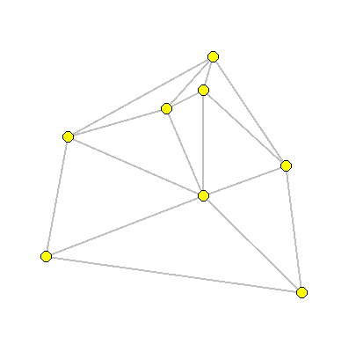
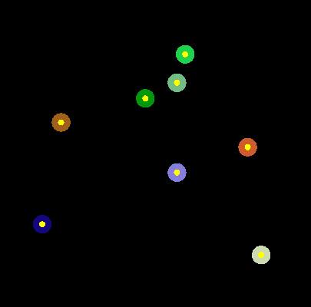
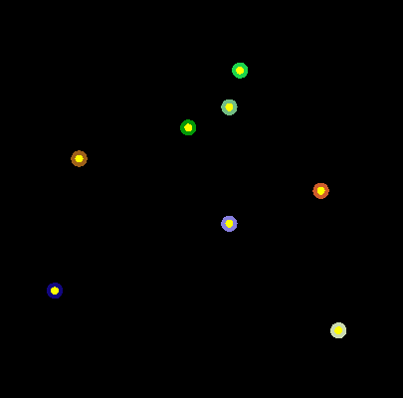
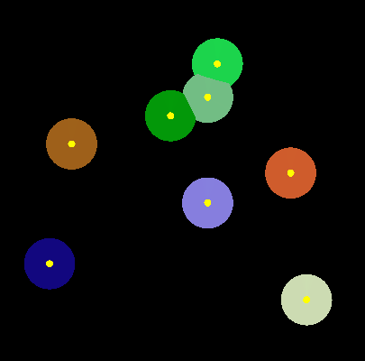
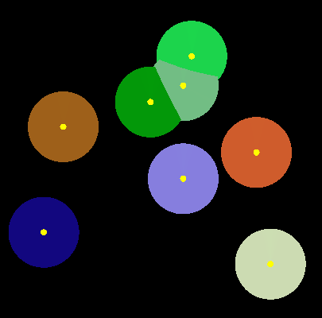
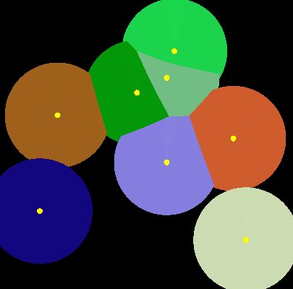
Delaunay Triangulation [Boris Delaunay ’34]
G
e
n
e
r
a
l
P
o
s
i
t
i
o
n
:
N
o
3
p
o
i
n
t
s
c
o
l
l
i
n
e
a
r
N
o
4
p
o
i
n
t
s
c
o
-
c
i
r
c
u
l
a
r
.
A
l
t
e
r
n
a
t
i
v
e
d
e
f
:
T
h
e
r
e
i
s
a
n
e
d
g
e
(
s
i
s
j
)
i
i
f
t
h
e
r
e
i
s
a
n
e
m
p
t
y
c
i
r
c
l
e
s
u
p
p
o
r
t
i
n
g
;
s
i
a
n
d
s
j
.
)
:
e
a
c
h
f
a
c
e
i
s
s
u
p
p
o
r
t
e
d
b
y
a
n
e
m
p
t
y
c
i
r
c
l
e
.

Slide 4
Delaunay realizability
A combinatorial triangulation T is Delaunay realizable if it exists S such that T =Delaunay(S).
α₂
β₁
General Lemma: In a Delaunay triangulation, if 2 faces ACD and BCD share an edge then:
β₂
α₁
α₃
β₃
α+ β <π
2 triangulations that are not Delaunay realizable
D
A
$′$₂
$$₂
$$₃
$′$₁
B
$$₁
$′$₃
$$₄
$′$₄
C

Slide 5
Why Delaunay realizability is an interesting question?
What is the probability of a random triangulation to be Delaunay realizable?
Is it enough to test a program on random Delaunay triangulations?
Can I make an algorithm dedicated to Delaunay triangulations more efficient than for general triangulations?
For instance can I encode every n-vertex Delaunay triangulation with less than 3.24n bits?

Slide 6
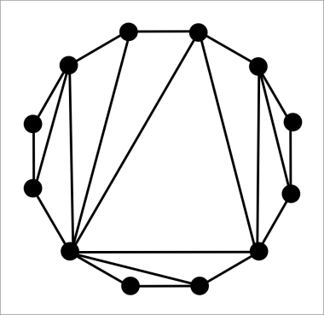
Delaunay realizability (related work)
Sufficient condition:
[Dillencourt’90] outerplanar triangulation
[Dillencourt Smith’96] triangulation without chords or nonfacial triangles
(chord: edge between 2 nonconsecutive vertices of the outerface)
Recognizability:
[Hodgson Rivin Smith ’92][Hiroshima Miayamoto Sugihara’00] polynomial time.

Slide 7
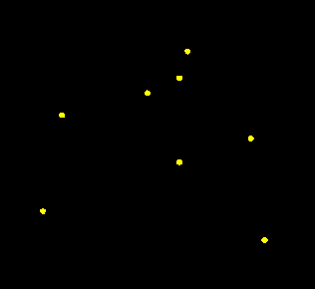
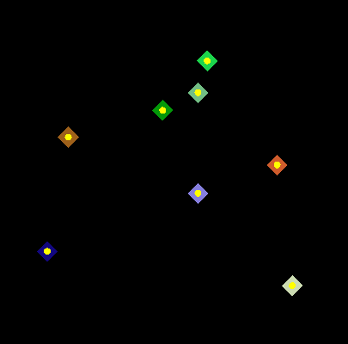
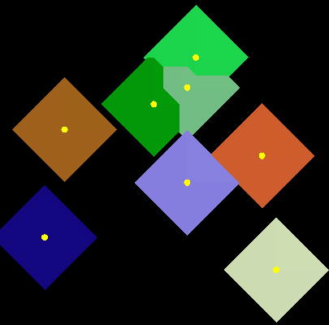
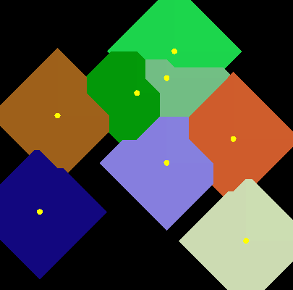
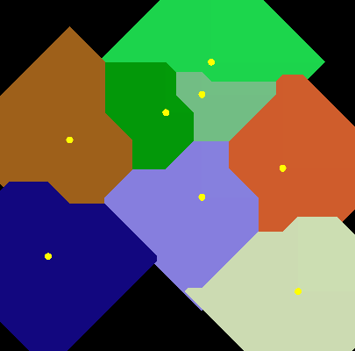
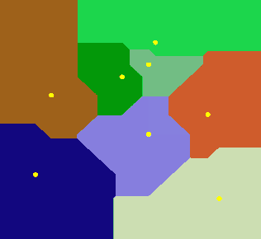
L∞-Delaunay Triangulation [Chew SoCG’86]

Slide 8
Necessary condition
Prop: If a (combinatorial) triangulation is L∞-Delaunay realizable then it doesn’t contain nonfacial triangles.
Proof: the rectangle supporting each edge is empty. The union of the rectangles supporting the edges of a triangle covers the interior of that triangle.

Slide 9
L∞-Delaunay realizable vs L₂-Delaunay realizable
L ∞-Delaunay realizable
but not L₂-Delaunay realizable
L₂-Delaunay realizable
but not L ∞-Delaunay realizable

Slide 10
Let’s make a digression through TD-Delaunay triangulations…

Slide 11
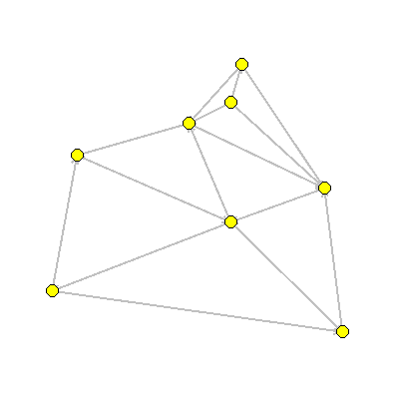
Triangular Distance Delaunay Triangulation [Chew 89]
Triangular “Distance”:
d(u,v) = size of the smallest equilateral triangle centred at u touching v.
Remark: in general d(u,v) ≠ d(v,u)
v
u
d(u,v)
Thm [B. Gavoille Hanusse Ilcinkas’10]:
Every combinatorial triangulation is TD-Delaunay realizable.

Slide 12
Schnyder woods [Schnyder’89]
Schnyder wood: coloration and orientation of edges such that around every inner vertex:
We can define a SW of TD-Delaunay: color and orientation of edges are determined by the slope:
+
-
-
+
+
-
Thm [B. Gavoille Hanusse Ilcinkas’10]:
Every Schnyder wood is TD-Delaunay realizable.

Slide 13
Why Delaunay realizability is an interesting question?
What is the probability of a random triangulation to be TD-Delaunay realizable? 1
Is it enough to test a program on random TD-Delaunay triangulations? Yes
Can I make an algorithm dedicated to TD-Delaunay triangulations more efficient than for general triangulations? No
For instance can I encode every n-vertex TD-Delaunay triangulation with less than 3.24n bits? No

Slide 14
Let’s come back to L∞-Delaunay triangulations…
Is there an equivalent to Schnyder woods for L∞-Delaunay triangulations?

Slide 15
Regular edge labelings/Transversal structures [Kant He ’97][Fusy ’05]
Let T be a combinatorial triangulation without nonfacial triangles and with 4 vertices on the outerface.
Transversal structure: coloration and orientation of edges such that:
Source: E. Fusy
We can define transversal structures of L∞-Delaunay triangulation using:
Positive slope edges → red
Negative slope edges → blue
Orient edges from left to right.
-
Natural question: Is every transversal structure L∞-Delaunay realizable?

Slide 16
Is every transversal structure L∞-Delaunay realizable? No ☹
Edge (d,c) is in an empty square ⇒ y_{d}-y_{c} < x_{b}-x_{a}
j
Because of path e,O,a,c,b,f : x_{e} < x_{a} < x_{c} < x_{b} < x_{f} ⇒ x_{b}-x_{a} < x_{f} –x_{e}
g
f
e
Edge (e,f) is in an empty square ⇒ x_{f}-x_{e} < y_{g}-y_{d}
d
b
Because of path i,O,d,f,g,j : y_{i} < y_{d} <y_{f} < y_{g} <y_{j} ⇒ y_{g}-y_{d} < y_{j} –y_{i}
h
Edge (i,j) is in an empty square ⇒ y_{j}-y_{i} < x_{e}-x_{h}
Because of path k,h,j,e,O,a: x_{k}<x_{h}<x_{j}<x_{e}<x_{a} ⇒ x_{e}-x_{h} < x_{a}-x_{k}
Ege (k,a) is in an empty square ⇒ x_{a}-x_{k} < y_{i}-y_{l}
Because of path c,l,k,i,O,d: y_{c} <y_{l} <y_{k}<y_{i}<y_{d} ⇒ y_{i}-y_{l} < y_{d}-y_{c}
i
a
k
l
c
Putting all together:
y_{d}-y_{c} < x_{b}-x_{a} < x_{f}-x_{e}< y_{g}-y_{d}<y_{j}-y_{i}<x_{e}-x_{h}<x_{a}-x_{k}<y_{i}-y_{l}<y_{d}-y_{c}
Contradiction: y_{d}-y_{c} < y_{d}-y_{c}

Slide 17
Is every transversal structure L∞-Delaunay realizable? No ☹ But…
j
g
j
g
f
e
f
e
Flip operation:
d
d
b
b
h
h
i
i
a
a
k
k
l
l
c
c

Slide 18
Sufficient condition
Thm: Every transversal structure without blue anti-N or red N is L∞-Delaunay realizable.
Remarks:
Not every 4-connected triangulation admits a transversal structure without blue anti-N or red N.
Every 4-connected triangulation admits a transversal structure without blue N or red N.
Thm [Fusy 08]: The following objects are in bijection:
Transversal structures without blue N or red N
Transversal structures without blue anti-N or red N
Baxter permutations.
We will use this bijection to obtain L∞-Delaunay realization.

Slide 19
Given the red edges, there is a unique to add blue edges without creating a blue N (or a blue anti-N)

Slide 20
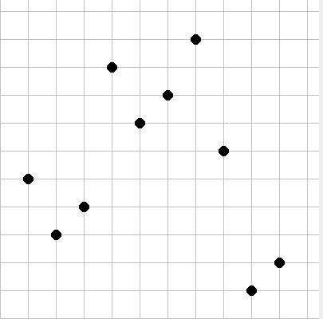
TS without blue N or red N ↓ Baxter Permutations
7
10
4
9
6
8
5
7
6
8
1
5
4
3
10
3
2
2
9
1
π = 5 3 4 9 7 8 10 6 1 2
T_{x}
T_{y}

Slide 21
Baxter Permutation [Baxter’64]
is a Baxter permutation if :
1) For each ascent a
2) For each descent d
a
a+1
l_{a}+1
l_{a}
l_{d}+1
l_{d}
π = 5 3 4 9 7 8 10 6 1 2
d
d+1

Slide 22
Baxter Permutations ↓ TS without blue N or red N
a
a+1
1) For each ascent a
2) For each descent d
l_{a}+1
l_{a}
l_{d}+1
l_{d}
π = 5 3 4 9 7 8 10 6 1 2
d
d+1

Slide 23
Baxter Permutations ↓ TS without blue anti-N or red N
a
a+1
1) For each ascent a
2) For each descent d
l_{a}+1
l_{a}
l_{d}+1
l_{d}
π = 5 3 4 9 7 8 10 6 1 2
d
d+1

Slide 24
TS without blue anti-N or red N ↓ L∞-Delaunay triangulations
For each ascent a (resp. descent d), inflate the corresponding row l_{a} (resp. l_{d}) such that the diagonal edge has slope +/-45°.
a
a+1
a
a+1
l_{a}+1
l_{a}+1
l_{d}+1
l_{a}
l_{d}+1
l_{a}
l_{d}
l_{d}
d
d+1
d
d+1

Slide 25
TS without blue anti-N or red N ↓ L∞-Delaunay triangulations
a
a+1
l_{d}+1
l_{a}+1
l_{d}
l_{a}
d
d+1

Slide 26
TS without blue anti-N or red N ↓ L∞-Delaunay triangulations

Slide 27
Conclusion
Is every triangulation without non-facial triangle L∞-Delaunay realizable?
Not so many progress on this question ☹
If yes, can we compute efficiently a corresponding L∞-Delaunay triangulation?
If not can we decide in polynomial time if a triangulation is L∞-Delaunay realizable?
If not can we decide in polynomial time if a transversal structure is L∞-Delaunay realizable?

