Slide 1

Elements of Combinatorial Topology
Companion slides for
Distributed Computing
Through Combinatorial Topology
Maurice Herlihy & Dmitry Kozlov & Sergio Rajsbaum
TexPoint fonts used in EMF.
Read the TexPoint manual before you delete this box.: AAAA
Notes:
1

Slide 2
In the Beginning …
1
0
1
1
0
1
0
a computer was just a Turing machine …
Distributed Computing though Combinatorial Topology
Notes:
In the beginning, a computer was a single processor. A rich theory grew up studying what single processors can and can’t do.

Slide 3
Today
?
?
?
Computing is co-ordination and communication
3
Notes:
Today, however, there are many computers. Sometimes these computers are very far apart, as on the Internet. Sometimes they are closer, as in a sensor network. Sometimes they are close, as in a multicore chip. And sometimes they are very close, as in a graphics processor.

Slide 4
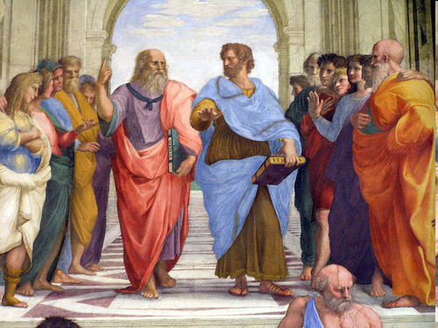
Distributed computations unfold in time!
No, distributed computations are static mathematical objects!
Operational versus combinatorial approaches …
Background picture: School of Athens, Rafael
https://www.flickr.com/photos/stefanorometours/6796909455/in/photolist-6mya9T-bmBWo4-bmC4SR-bmBXrX-5cVEjb-6tnNmZ-bmBN9F-bmBLAn-bmBRkD-c4R8yh-c4R7bf-5HjLsE-6hGXZP-5HfsGp-8AKAmu-3L5n1D-68Gdnh-6tnLn4-7jgvsw-62WQie-62WLc8-afPWHf-NDCTi-c4RdgJ-c4ReUL-aioxzs-aidE1S-5HjLnJ-aidE9S-5y2S6B-aod9e9-5HjLjf-aDtLVY-a82rdi-a85ipS-aiFh6A-7KfgxW-68Gck5-68Ge21-dDw7BG-ajP4ho-8FBjh3-a85PH5-aDtLVW-a82rfz-a82r9B-aiAzJD-bv8CA1-aiCuFz-aiowBd/
https://creativecommons.org/licenses/by/2.0/legalcode

Slide 5
Muddy Children
11:00
Notes:
A group of children is playing in the garden …

Slide 6
Muddy Children
11:01
Notes:
and some of them end up with mud on their foreheads. Each child can see the other children's foreheads, but not its own.

Slide 7
Muddy Children
12:00
At least one of you is dirty!
Notes:
At noon, their teacher summons the children and says: ``At least one of you has a muddy forehead.

Slide 8
Muddy Children
12:00
You may not communicate!
Notes:
You are not allowed to communicate with one another about it in any manner.

Slide 9
Muddy Children
12:00
When you realize you are dirty, confess on the hour!
Notes:
But
whenever you become certain that you are dirty, you must announce it to everybody, exactly on the hour.

Slide 10
Muddy Children
1:00
(silence …)
Notes:
The children resume playing normally, and nobody mentions the state of anyone's forehead.

Slide 11
Muddy Children
2:00
Me!
Me!
Notes:
There were two muddy children, and at 2:00 they both announce themselves. How does this work?

Slide 12
Operational Explanation
1:00
Notes:
There were two muddy children, and at 2:00 they both announce themselves. How does this work?

Slide 13
Operational Explanation
Others are clean, so I must be dirty.
1:00
Notes:
There were two muddy children, and at 2:00 they both announce themselves. How does this work?

Slide 14
Operational Explanation
Others are clean, so I must be dirty.
1:00
Me!
Notes:
There were two muddy children, and at 2:00 they both announce themselves. How does this work?

Slide 15
Operational Explanation
1:01
Notes:
There were two muddy children, and at 2:00 they both announce themselves. How does this work?

Slide 16
Operational Explanation
He was quiet, so I must be dirty.
1:01
He was quiet, so I must be dirty.
Notes:
There were two muddy children, and at 2:00 they both announce themselves. How does this work?

Slide 17
Combinatorial Explanation
12:00
Notes:
A child's \emph{input} is its initial state of knowledge.

Slide 18
Combinatorial Explanation
12:00
Notes:
A child's \emph{input} is its initial state of knowledge.

Slide 19
Combinatorial Explanation
12:00
Each process has its own input
Notes:
A child's \emph{input} is its initial state of knowledge.

Slide 20
Combinatorial Explanation
01?
?11
12:00
0?1
Each process has its own input
Notes:
A child's \emph{input} is its initial state of knowledge.

Slide 21
Combinatorial Explanation
01?
?11
12:00
Global State
0?1
Notes:
A child's \emph{input} is its initial state of knowledge.

Slide 22
11:59
all clean
00?
0? 0
?00
0?1
01?
?01
?1 0
10?
1? 0
?11
1?1
11?
all dirty
Notes:
For three children, here are the possible initial configurations. Each vertex represents a child's possible input. Each vertex is labeled with an input vector, and colored to identify the corresponding child. Each possible configuration is represented as a solid triangle, linking \emph{compatible} states for the three children. The triangle at the very top represents the configurations where all three children are clean, the one at the bottom where they are all dirty, and the triangles in between represent configurations where some are clean and some are dirty.

Slide 23
12:01
00?
0? 0
?00
0?1
01?
?01
?1 0
10?
1? 0
?11
1?1
11?
all dirty
Notes:
For three children, here are the possible initial configurations. Each vertex represents a child's possible input. Each vertex is labeled with an input vector, and colored to identify the corresponding child. Each possible configuration is represented as a solid triangle, linking \emph{compatible} states for the three children. The triangle at the very top represents the configurations where all three children are clean, the one at the bottom where they are all dirty, and the triangles in between represent configurations where some are clean and some are dirty.

Slide 24
1:01
0?1
01?
?01
?1 0
10?
1? 0
?11
1?1
11?
all dirty
Notes:
For three children, here are the possible initial configurations. Each vertex represents a child's possible input. Each vertex is labeled with an input vector, and colored to identify the corresponding child. Each possible configuration is represented as a solid triangle, linking \emph{compatible} states for the three children. The triangle at the very top represents the configurations where all three children are clean, the one at the bottom where they are all dirty, and the triangles in between represent configurations where some are clean and some are dirty.

Slide 25
2:01
?11
1?1
11?
all dirty
Notes:
For three children, here are the possible initial configurations. Each vertex represents a child's possible input. Each vertex is labeled with an input vector, and colored to identify the corresponding child. Each possible configuration is represented as a solid triangle, linking \emph{compatible} states for the three children. The triangle at the very top represents the configurations where all three children are clean, the one at the bottom where they are all dirty, and the triangles in between represent configurations where some are clean and some are dirty.

Slide 26
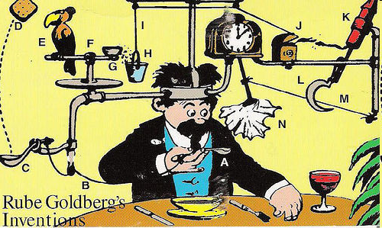
Operational Reasoning
http://commons.wikimedia.org/wiki/File:Professor_Lucifer_Butts.gif
Distributed Computing though Combinatorial Topology

Slide 27

Combinatorial Reasoning
http://commons.wikimedia.org/wiki/File:Blake_ancient_of_days.jpg

Slide 28
Combinatorial Reasoning
Model-independent properties …
http://commons.wikimedia.org/wiki/File:Blake_ancient_of_days.jpg

Slide 29
Combinatorial Reasoning
Model-independent properties …
… restricted model-dependent reasoning
http://commons.wikimedia.org/wiki/File:Blake_ancient_of_days.jpg

Slide 30
Road Map
Simplicial Complexes
Standard Constructions
Carrier Maps
Connectivity
Subdivisions
Simplicial & Continuous Approximations

Slide 31
Road Map
Simplicial Complexes
Standard Constructions
Carrier Maps
Connectivity
Subdivisions
Simplicial & Continuous Approximations

Slide 32
A Vertex
Notes:
We will build our constructions out of vertices (sing. vertex). From a geometric view, we can think of a vertex as being a point in a sufficiently high-dimensional Euclidean space. From an abstract combinatorial view, a vertex is just an element taken from some domain of elements.

Slide 33
A Vertex
Combinatorial: an element of a set.
Notes:
We will build our constructions out of vertices (sing. vertex). From a geometric view, we can think of a vertex as being a point in a sufficiently high-dimensional Euclidean space. From an abstract combinatorial view, a vertex is just an element taken from some domain of elements.

Slide 34
A Vertex
Combinatorial: an element of a set.
Geometric: a point in high-dimensional Euclidean Space
Notes:
We will build our constructions out of vertices (sing. vertex). From a geometric view, we can think of a vertex as being a point in a sufficiently high-dimensional Euclidean space. From an abstract combinatorial view, a vertex is just an element taken from some domain of elements.

Slide 35
Simplexes
0-simplex
1-simplex
2-simplex
3-simplex
Notes:
A simplex is a set of vertices. Geometrically, we draw simplexes as the convex hull of affinely-independent points. The dimension of a simplex is one less than its number of edges.

Slide 36
Simplexes
Combinatorial: a set of vertexes.
0-simplex
1-simplex
2-simplex
3-simplex
Notes:
A simplex is a set of vertices. Geometrically, we draw simplexes as the convex hull of affinely-independent points. The dimension of a simplex is one less than its number of edges.

Slide 37
Simplexes
Combinatorial: a set of vertexes.
Geometric: convex hull of points in general position
0-simplex
1-simplex
2-simplex
3-simplex
Notes:
A simplex is a set of vertices. Geometrically, we draw simplexes as the convex hull of affinely-independent points. The dimension of a simplex is one less than its number of edges.

Slide 38
Simplexes
Combinatorial: a set of vertexes.
Geometric: convex hull of points in general position
0-simplex
1-simplex
dimension
2-simplex
3-simplex
Notes:
A simplex is a set of vertices. Geometrically, we draw simplexes as the convex hull of affinely-independent points. The dimension of a simplex is one less than its number of edges.

Slide 39
Simplicial Complex
Notes:
A simplicial complex is a set of simplexes closed under inclusion. Geometrically, any two simplices intersect in a common face, which can be empty.

Slide 40
Simplicial Complex
Combinatorial: a set of simplexes close under inclusion.
Notes:
A simplicial complex is a set of simplexes closed under inclusion. Geometrically, any two simplices intersect in a common face, which can be empty.

Slide 41
Simplicial Complex
Combinatorial: a set of simplexes close under inclusion.
Geometric: simplexes “glued together” along faces …
Notes:
A simplicial complex is a set of simplexes closed under inclusion. Geometrically, any two simplices intersect in a common face, which can be empty.

Slide 42
Graphs vs Complexes
Notes:
A simplicial complex is a set of simplexes closed under inclusion. Geometrically, any two simplices intersect in a common face, which can be empty.

Slide 43
Graphs vs Complexes
dimension 0 or 1
Notes:
A simplicial complex is a set of simplexes closed under inclusion. Geometrically, any two simplices intersect in a common face, which can be empty.

Slide 44
Graphs vs Complexes
dimension 0 or 1
arbitrary dimension
Notes:
A simplicial complex is a set of simplexes closed under inclusion. Geometrically, any two simplices intersect in a common face, which can be empty.

Slide 45
Graphs vs Complexes
dimension 0 or 1
arbitrary dimension
complexes are a natural generalization of graphs
Notes:
A simplicial complex is a set of simplexes closed under inclusion. Geometrically, any two simplices intersect in a common face, which can be empty.

Slide 46
Abstract Simplicial Complex
finite set V with a collection K of subsets of V, such that …
Notes:
The singleton set containing each vertex is in the graph. Usually we will be casual about the distinction between a vertex and its singleton set.

Slide 47
Abstract Simplicial Complex
finite set V with a collection K of subsets of V, such that …
for all s 2 S, {s} 2 K
Notes:
The singleton set containing each vertex is in the complex. Usually we will be casual about the distinction between a vertex and its singleton set.

Slide 48
Abstract Simplicial Complex
finite set S with a collection K of subsets of S, such that …
for all s 2 S, {s} 2 K
for all X 2 K, and Y ½ X, Y 2 K
Notes:
Graphs are closed under inclusion. If X is a simplex in \cK, and Y is a subset of X, then X is also in \cG. For graphs, this just says that if an edge is in the graph, so are its two vertices.

Slide 49
Geometric Simplicial Complex
A collection of geometric simplices in R^{d} such that
Notes:
With geometric simplicial complexes, we are talking about subspaces of Euclidean space.

Slide 50
Geometric Simplicial Complex
A collection of geometric simplices in R^{d} such that
any face of a ¾2K is also in K
Notes:
First, geometric complexes are also closed under inclusion.

Slide 51
Geometric Simplicial Complex
A collection of geometric simplices in R^{d} such that
any face of a ¾2K is also in K
for all ¾,¿ 2 K, their intersection
¾ Å ¿ is a face of each of them.
Notes:
Second, we require that geometric simplices in complex fit together nicely. For any two simplices, there intersection must be a face of both (possibly empty).

Slide 52
Abstract vs Geometric Complexes

Slide 53
Abstract vs Geometric Complexes
Abstract: A

Slide 54
Abstract vs Geometric Complexes
Abstract: A
Geometric: |A|

Slide 55
Simplicial Maps
Vertex-to-vertex map …
A
Á
B

Slide 56
Simplicial Map
Vertex-to-vertex map …
A
that sends simplexes to simplexes
Á
B
Á: A ! B

Slide 57
Road Map
Simplicial Complexes
Standard Constructions
Carrier Maps
Connectivity
Subdivisions
Simplicial & Continuous Approximations

Slide 58
Skeleton
C
(solid tetrahedron)
skel² C
(hollow tetrahedron)
skel¹ C
skel⁰ C

Slide 59
Facet
A facet of K is a simplex of maximal dimension

Slide 60
Star
Star(¾,K) is the complex of facets of K containing ¾
Complex

Slide 61
Open Star
Starº(¾,K) union of interiors of simplexes containing ¾
Point Set

Slide 62
Link
Link(¾,K) is the complex of simplices of Star(¾,K) not containing ¾
Complex

Slide 63
Road Map
Simplicial Complexes
Standard Constructions
Carrier Maps
Connectivity
Subdivisions
Simplicial & Continuous Approximations

Slide 64
Carrier Map
©
A
B
Maps simplex of A
to subcomplex of B
©: A ! 2^{B}

Slide 65
Carrier Maps are Monotonic
©
A
B
If ¿ µ ¾ then ©(¿) µ ©(¾)
or
for ¾,¿ 2 A, ©(¾Å¿) µ ©(¾)Å©(¿)

Slide 66
Example
©
Notes:
66
simplicialVScarrierMap.eps

Slide 67
Example
©
on vertices
Notes:
67
simplicialVScarrierMap.eps

Slide 68
Example
©
on edges
There is no simplicial map carried by ©
Notes:
68
simplicialVScarrierMap.eps

Slide 69
Strict Carrier Maps
©
A
B
for all ¾,¿ 2 A, ©(¾Å¿) = ©(¾)Å©(¿)

Slide 70
Strict Carrier Maps
©
A
B
for all ¾,¿ 2 A, ©(¾Å¿) = ©(¾)Å©(¿)
replace µ with =

Slide 71
Rigid Carrier Maps
©
A
B
for ¾ 2 A, ©(¾) is pure of dimension dim ¾

Slide 72
Carrier of a Simplex
©
A
B
given strict ©: A ! 2^{B}

Slide 73
Carrier of a Simplex
©
A
B
given strict ©: A ! 2^{B}
for each ¿ 2 B,
9 unique smallest ¾ 2 A such that ¿ 2 ©(¾).

Slide 74
Carrier of a Simplex
©
A
B
given strict ©: A ! 2^{B}
for each ¿ 2 B,
9 unique smallest ¾ 2 A such that ¿ 2 ©(¾).
¾ = Car(¿, ©(¾))
sometimes
omitted

Slide 75
Carrier of a Simplex
©
A
B
given strict ©: A ! 2^{B}
for each ¿ 2 B,
9 unique smallest ¾ 2 A such that ¿ 2 ©(¾).
¾ = Car(¿, ©(¾))
sometimes
omitted

Slide 76
Simplicial Map Carried By Carrier Map
Given carrier and simplicial maps
©: A ! 2^{B}
ϕ: A ! B
ϕ is carried by © if

Slide 77
Simplicial Map Carried By Carrier Map
Given carrier and simplicial maps
©: A ! 2^{B}
ϕ: A ! B
ϕ is carried by © if
for all ¾ 2 A, ϕ(¾) µ ©(¾)

Slide 78
Simplicial Map Carried By Carrier Map
Given carrier and simplicial maps
©: A ! 2^{B}
ϕ: A ! B
ϕ is carried by © if
for all ¾ 2 A, ϕ(¾) µ ©(¾)
written: ϕ µ ©

Slide 79
Continuous Map Carried By Carrier Map
Given carrier and continuous maps
©: A ! 2^{B}
f: |A| ! |B|

Slide 80
Continuous Map Carried By Carrier Map
Given carrier and continuous maps
©: A ! 2^{B}
f: |A| ! |B|
f is carried by © if

Slide 81
Continuous Map Carried By Carrier Map
Given carrier and continuous maps
©: A ! 2^{B}
f: |A| ! |B|
f is carried by © if
for all ¾ 2 A, f(¾) µ |©(¾)|

Slide 82
Colorings
¢^{n} :=

Slide 83
Chromatic Complex
Â
A
¢^{n}
rigid simplicial map

Slide 84
Color-Preserving Simplicial Map
ϕ
A
¢^{n}
color of v = color of ϕ(v)

Slide 85
Road Map
Simplicial Complexes
Standard Constructions
Carrier Maps
Connectivity
Subdivisions
Simplicial & Continuous Approximations

Slide 86
A Path
simplicial
complex
vertex
edge
edge
edge
edge
vertex
vertex
vertex
vertex

Slide 87
Path Connected
Any two vertexes can be linked by a path

Slide 88
Rethinking Path Connectivity
0-sphere
Let’s call this complex 0-connected
1-disc

Slide 89
1-Connectivity
1-sphere
2-disc

Slide 90
This Complex is not 1-Connected
?

Slide 91


2-Connectivity
2-sphere
3-disk

Slide 92
n-connectivity
C is n-connected, if, for m · n, every continuous map of the m-sphere
can be extended to a continuous map of the (m+1)-disk

Slide 93
n-connectivity
C is n-connected, if, for m · n, every continuous map of the m-sphere
can be extended to a continuous map of the (m+1)-disk
(-1)-connected is non-empty

Slide 94
Road Map
Simplicial Complexes
Standard Constructions
Carrier Maps
Connectivity
Subdivisions
Simplicial & Continuous Approximations

Slide 95
Subdivisions
Notes:
A geometric complex is subdivided by partitioning each of its simplexes into smaller simplexes without changing the complex's polyhedron.

Slide 96
Subdivisions
Notes:
A geometric complex is subdivided by partitioning each of its simplexes into smaller simplexes without changing the complex's polyhedron.

Slide 97
B is a subdivision of A if …
¯
For each simplex ¯ of B there is a simplex ® of A such that |¯| µ |®|.
®
Notes:
A geometric complex is subdivided by partitioning each of its simplexes into smaller simplexes without changing the complex's polyhedron.

Slide 98
B is a subdivision of A if …
¯
For each simplex ¯ of B there is a simplex ® of A such that |¯| µ |®|.
®
For each simplex ® of A, |®| is the union of a finite set of geometric simplexes of B.
Notes:
A geometric complex is subdivided by partitioning each of its simplexes into smaller simplexes without changing the complex's polyhedron.

Slide 99
Barycentric Subdivision
¾
Notes:
For our purposes, the most useful subdivision is the \emph{standard chromatic subdivision} defined as follows. Let $\cC$ be a chromatic complex.

Slide 100
Barycentric Subdivision
¾
Bary ¾
Notes:
For our purposes, the most useful subdivision is the \emph{standard chromatic subdivision} defined as follows. Let $\cC$ be a chromatic complex.

Slide 101
Barycentric Subdivision
¾
Notes:
For our purposes, the most useful subdivision is the \emph{standard chromatic subdivision} defined as follows. Let $\cC$ be a chromatic complex.

Slide 102
Barycentric Subdivision
Each vertex of Bary ¾ is a face of ¾
¾
Notes:
For our purposes, the most useful subdivision is the \emph{standard chromatic subdivision} defined as follows. Let $\cC$ be a chromatic complex.

Slide 103
Barycentric Subdivision
Each vertex of Bary ¾ is a face of ¾
¾
Notes:
For our purposes, the most useful subdivision is the \emph{standard chromatic subdivision} defined as follows. Let $\cC$ be a chromatic complex.

Slide 104
Barycentric Subdivision
Each vertex of Bary ¾ is a face of ¾
Simplex = faces ordered by inclusion
¾
Notes:
For our purposes, the most useful subdivision is the \emph{standard chromatic subdivision} defined as follows. Let $\cC$ be a chromatic complex.

Slide 105
Barycentric Coordinates
v₀
x = t₀ v₀ + t₁ v₁ + t₂ v₂
0 · t₀,t₁,t₂ · 1
x
∑ t_{i} = 1
v₂
v₁
Every point of |C| has a unique representation using barycentric coordinates

Slide 106
Standard Chromatic Subdivision
Notes:
subdivisions
106

Slide 107
Standard Chromatic Subdivision
Ch ¾
Notes:
subdivisions
107

Slide 108
Standard Chromatic Subdivision
Ch ¾
Chromatic form of Barycentric
Notes:
subdivisions
108

Slide 109
Road Map
Simplicial Complexes
Standard Constructions
Carrier Maps
Connectivity
Subdivisions
Simplicial & Continuous Approximations

Slide 110
From Simplicial to Continuous
simplicial
continuous
Notes:
One direction is easy. Any simplicial map $\phi:\cA~\to~\cB$ can be turned into a piece-wise linear map $|\phi|:|\cA|~\to~|\cB|$ by extending over barycentric coordinates.

Slide 111
From Simplicial to Continuous
simplicial
continuous
Notes:
One direction is easy. Any simplicial map $\phi:\cA~\to~\cB$ can be turned into a piece-wise linear map $|\phi|:|\cA|~\to~|\cB|$ by extending over barycentric coordinates.

Slide 112
From Simplicial to Continuous
simplicial
continuous
extend over barycentric coordinates
(piece-wise linear map)
Notes:
One direction is easy. Any simplicial map $\phi:\cA~\to~\cB$ can be turned into a piece-wise linear map $|\phi|:|\cA|~\to~|\cB|$ by extending over barycentric coordinates.

Slide 113
Maps
simplicial
continuous

Slide 114
Maps
simplicial
Simplicial Approximation Theorem
continuous

Slide 115
Simplicial Approximation
simplicial
continuous

Slide 116
Simplicial Approximation

Slide 117
Simplicial Approximation

Slide 118
Simplicial Approximation

Slide 119
Simplicial Approximation

Slide 120
Simplicial Approximation

Slide 121
Simplicial Approximation

Slide 122
Simplicial Approximation

Slide 123
Simplicial Approximation

Slide 124
Simplicial Approximation
Á is a simplicial approximation of f if …

Slide 125
Simplicial Approximation
Á is a simplicial approximation of f if …
for every v in A …

Slide 126
Simplicial Approximation Theorem
Given a continuous map
there is an N such that f has a simplicial approximation
Notes:
Not every continuous map $f:|\cA|~\to~|\cB|$ has a simplicial
approximation mapping $\cA$ to $\cB$.
The following theorem, however,
states we can always find a simplicial approximation defined over a
sufficiently refined subdivision of $\cA$.
We won’t prove this theorem here, since the proof can be found in any elementary Topology textbook.

Slide 127
Simplicial Approximation Theorem
Given a continuous map
there is an N such that f has a simplicial approximation
Actually holds for most other subdivisions….
Notes:
Not every continuous map $f:|\cA|~\to~|\cB|$ has a simplicial
approximation mapping $\cA$ to $\cB$.
The following theorem, however,
states we can always find a simplicial approximation defined over a
sufficiently refined subdivision of $\cA$.
We won’t prove this theorem here, since the proof can be found in any elementary Topology textbook.

Slide 128
Vertex = Process State
Process ID (color)
7
Value (input or output)

Slide 129
Simplex = Global State

Slide 130
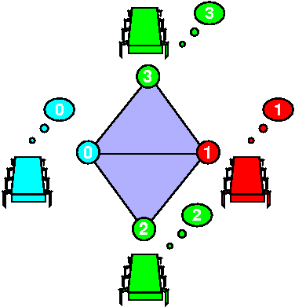
Complex = Global States

Slide 131
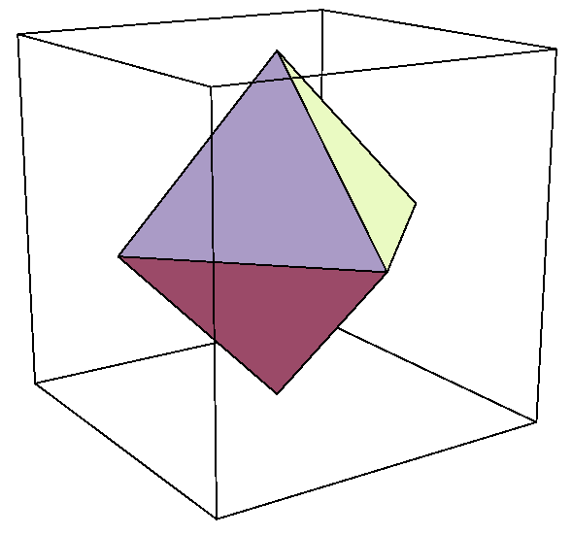
Input Complex for Binary Consensus
0
All possible initial states
0
1
0
Processes: red, green, blue
1
Independently assigned 0 or 1

Slide 132
Output Complex for Binary Consensus
All possible final states
0
0
0
1
Output values all 0 or all 1
1
1
Two disconnected simplexes

Slide 133
Carrier Map for Consensus
All 0 outputs
All 0 inputs

Slide 134
Carrier Map for Consensus
All 1 inputs
All 1 outputs

Slide 135
Carrier Map for Consensus
All 0 outputs
Mixed 0-1 inputs
All 1 outputs

Slide 136
Task Specification
(I, O, ¢)
Input complex
Carrier map
¢: I ! 2^{O}
Output complex

Slide 137
Colorless Tasks
(I, P, ¥)
(colorless) input complex
strict carrier map
¥: I ! 2^{P}
(colorless) protocol complex
Notes:
A colorless task is given by a set of colorless input assignments $\cI$, a set of colorless output assignments $\cO$, and a relation $\Delta$ which specifies, for each input assignment, which output assignments can be chosen. Note that a colorless task specification is independent of the number of participating processes, or their names.

Slide 138
Protocol Complex
Vertex: process name, view
all values read and written
Simplex: compatible set of views
Each execution defines a simplex

Slide 139
Example: Synchronous Message-Passing
Round 0
Round 1

Slide 140
Failures: Fail-Stop
Partial broadcast

Slide 141
Single Input: Round Zero
No messages sent
0
View is input value
0
0
Same as input simplex

Slide 142
Round Zero Protocol Complex
0
No messages sent
0
1
View is input value
0
1
Same as input complex

Slide 143
Single Input: Round One
0
0
0
0
0
0
0
0
0
0
0
0
0
0
0
0
0
0
0
0
0

Slide 144
Single Input: Round One
0
0
0
0
0
0
0
0
0
0
0
0
0
0
0
0
0
no one fails
0
0
0
0

Slide 145
Single Input: Round One
0
0
0
0
0
0
0
0
0
0
0
0
0
0
0
0
0
blue fails
no one fails
0
0
0
0

Slide 146
Single Input: Round One
red fails
green fails
0
0
0
0
0
0
0
0
0
0
0
0
0
0
0
0
0
blue fails
no one fails
0
0
0
0

Slide 147
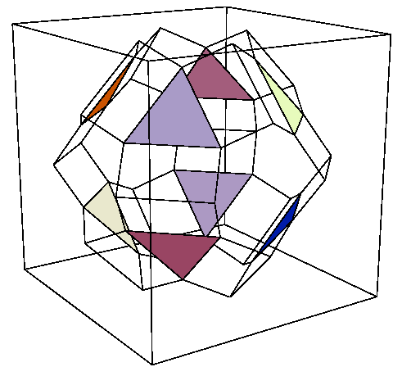
Protocol Complex: Round One

Slide 148
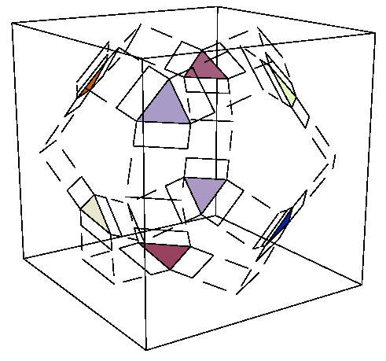
Protocol Complex: Round Two

Slide 149
Protocol Complex Evolution
zero
one
two

Slide 150
Summary
protocol complex
Ξ
δ
input complex
output complex
Δ

Slide 151
Decision Map
δ
Simplicial map, sending simplexes to simplexes
Protocol complex
Output complex

Slide 152
Lower Bound Strategy
δ
Find topological “obstruction” to this simplicial map
Protocol complex
Output complex

Slide 153
Consensus Example
Subcomplex of all-0 inputs
Must map here
0
0
δ
1
1
Protocol
Output

Slide 154
Consensus Example
0
0
δ
1
1
Protocol
Subcomplex of all-1 inputs
Must map here
Output

Slide 155
Consensus Example
Image under δ must start here ..
0
0
δ
1
1
Protocol
Path from
“all-0” to “all-1”
Output
and end here

Slide 156
Consensus Example
path
0
0
δ
?
1
1
Output

Slide 157
Consensus Example
Image under δ must start here ..
But this “hole” is an obstruction
δ
Protocol
Path from
“all-0” to “all-1”
Output
and end here

Slide 158
Simplicial Complex
Distributed Computing Through Combinatorial Topology
Notes:
A simplicial complex (or complex) is a set of simplexes closed under inclusion: if S and T are both in a complex then their intersection is either empty or a simplex in the complex.
Like simplexes, complexes can also be viewed both as combinatorial objects or as geometric objects.
The complex shown here is a kind of torus constructed by joining triangles together. Most of the complexes we will consider will not have such a nice geometric structure (though some will).

Slide 159
Manifolds
Every (n-1)-simplex a
face of two n-simplexes
Distributed Computing Through Combinatorial Topology
Notes:
A n-dimensional complex is a manifold (sometimes called a pseudo-manifold )if each (n-1)-simplex is contained in precisely two n-simplexes. This kind of manifold is also a manifold in the other sense, of looking locally like Euclidean space, but it is obviously not continuous.

Slide 160
Manifolds
Every (n-1)-simplex a
face of two n-simplexes
technically, a pseudo-manifold
Distributed Computing Through Combinatorial Topology
Notes:
A n-dimensional complex is a manifold (sometimes called a pseudo-manifold )if each (n-1)-simplex is contained in precisely two n-simplexes. This kind of manifold is also a manifold in the other sense, of looking locally like Euclidean space, but it is obviously not continuous.

Slide 161
Manifold with Boundary
Internal (n-1)-simplex a
face of two n-simplexes
Boundary ∂ C
Boundary (n-1)-simplex a
face of one n-simplex
Distributed Computing Through Combinatorial Topology
Notes:
A complex is a manifold with boundary if each (n-1)-simplex is contained in precisely one or two n-simplexes. An (n-1)-simplex is internal if it a face of two n-simplexes, and exernal otherwise. The subcomplex generated by the external (n-1)-simplexes is called the boundary of the manifold. Sometimes we just say “Manifold” when we mean “manifold with boundary”.

Slide 162
Why Manifolds?
Nice combinatorial properties
Many useful theorems
Easy to prove certain claims
Not all complexes are manifolds ….
But a good place to start.
Notes:
Few of the complexes that arise naturally in the study of distributed computing
are manifolds. We study them anyway because they provide an excellent way to
approach more complicated models. Manifolds have nice combinatorial properties
not shared with more general classes of complexes. Later, we will see how to
generalize the techniques developed here to other, more natural models of
computation.

Slide 163
Road Map
Manifolds
Immediate Snapshot Model
Sperner’s Lemma and k-Set Agreement
Weak Symmetry-Breaking
Separation results
Distributed Computing Through Combinatorial Topology

Slide 164
Immediate Snapshot Executions
Restricted form of Read-Write memory
Protocol complexes are manifolds
(Equivalent to regular R-W memory)
But we will not prove it yet.
Notes:
The \emph{immediate snapshot} model is a simplified model of computation whose
protocol complexes are manifolds. These executions are constrained, in the
sense that they encompass only a subset of the interleavings possible in an
asynchronous model. Nevertheless, any \emph{impossibility} results that we
prove for a restricted set of interleavings are valid for the less restricted
model. It is easy to see why: solving a task in a distributed system means
that the outputs should be valid in \emph{every} execution. So if we can show
a subset of executions where no valid decision is possible, then no valid
decision is possible in general. Another way to formulate this observation is
to imagine that executions are chosen by an ``adversary'' who always chooses
the worst set of executions.

Slide 165
Write
1
0
0
0
Single-writer, multi-reader variables
Distributed Computing Through Combinatorial Topology
Notes:
Consider an asynchronous system where $n+1$ processes share an $(n+1)$-element
array $m$. When process $P_i$ is scheduled to run, it writes its state to
$m[i]$,

Slide 166
Snapshot
100
1
0
0
Single-writer, multi-reader variables
Distributed Computing Through Combinatorial Topology
Notes:
When process $P_i$ is scheduled to run, it writes its state to $m[i]$, and then
atomically reads the entire array. (We call such an atomic read a
\emph{snapshot}, and its result a \emph{view}.)

Slide 167
Immediate Snapshot Executions
Pick a set of processes
Repeat with another set
write together
snapshot together
Notes:
For simplicity, we restrict how these steps can be interleaved. Each execution
is divided into a sequence of \emph{phases}. In each phase, select a set of
processes that have not yet taken a step. All processes in that set
simultaneously write, and then they simultaneously take a memory snapshot.
Phases proceed until every process has been scheduled exactly once. Because
each snapshot is scheduled immediately after the preceding write, we call this
the \emph{immediate snapshot} model.

Slide 168
Example Executions
Each process writes, then takes snapshot
P | Q | R
write
snap
 | write
 | snap
 |  | write
 |  | snap
P?? | PQ? | PQR
time
Each process has a view

Slide 169
Example Executions
P | Q | R
write
snap
 | write | write
 | snap | snap
 |  | write
 |  | snap
P?? | PQR | PQR
P | Q | R
write
snap
 | write
 | snap
 |  | write
 |  | snap
P?? | PQ? | PQR
Moving last process
one round earlier,
Changes this view from PQ? to PQR

Slide 170
Example Executions
P | Q | R
write | write | write
snap | snap | snap
 | write | write
 | snap | snap
PQR | PQR | PQR
P | Q | R
write | write | write
snap | snap | snap
 | write | write
 | snap | snap
PQR | PQR | PQR
P | Q | R
write
snap
 | write | write
 | snap | snap
 |  | write
 |  | snap
P?? | PQR | PQR
Moving last processes
one round earlier,
Changes this view from P?? to PQR

Slide 171
Protocol Complex
Process (color) & view
Notes:
This slide shows the full immediate snapshot complex for three
processes. Informally, we can see that this complex is a manifold, although
such a claim requires proof.

Slide 172
Protocol Complex
P | Q | R
write
snap
 | write
 | snap
 |  | write
 |  | snap
P | Q | R
write | write | write
snap | snap | snap
P | Q | R
write
snap
 | write | write
 | snap | snap

Slide 173
Standard Chromatic Subdivision
Distributed Computing Through Combinatorial Topology
Notes:
We will call this simplex the standard chromatic subdivision, even though we haven’t proved it’s a subdivision, or even defined what a subdivision is. We will discuss subdivisions later, so for now it’s just a complex given by the combinatorial definition that follows.

Slide 174
Sperner Coloring

Slide 175
Sperner Coloring
“Corners” have distinct colors

Slide 176
Sperner Coloring
“Corners” have distinct colors
Edge vertexes have corner colors

Slide 177
Sperner Coloring
“Corners” have distinct colors
Edge vertexes have corner colors
Every vertex has face boundary colors

Slide 178
Sperner’s Lemma
In any Sperner coloring, at least one n-simplex has all n+1 colors

Slide 179
No Manifold Task can solve n-Set Agreement
Assume protocol exists:
Run manifold task protocol
Choose value based on vertex
Idea:
Color vertex with “winning” process name …
Distributed Computing Through Combinatorial Topology

Slide 180
Manifold Task for n-Set Agreement
manifold
Only P wins
Sperner coloring
Only Q and R win
Distributed Computing Through Combinatorial Topology

Slide 181
Manifold Task for n-Set Agreement
manifold
Sperner coloring
Distributed Computing Through Combinatorial Topology

Slide 182
Manifold Task for n-Set Agreement
manifold
Sperner coloring
n+1 colors
Execution with n+1 winners
Contradiction: at most n can win
Distributed Computing Through Combinatorial Topology

Slide 183
Road Map
Manifolds
Immediate Snapshot Model
Sperner’s Lemma and k-Set Agreement
Weak Symmetry-Breaking
Separation results
Distributed Computing Through Combinatorial Topology

Slide 184
Weak Symmetry-Breaking
If all processes participate …
At least one process in each group
Group 1
Group 0
Notes:
Weak symmetry-breaking requires breaking processes into two groups.

Slide 185
Weak Symmetry-Breaking
If fewer participate …
we don’t care.
Group 1
Group 0
Notes:
Weak symmetry-breaking requires breaking processes into two groups.

Slide 186
Anonymous Protocols
Trivial solution: choose name parity
WSB protocol should be anonymous
Output depends on …
Input …
But not name
Interleaving …
Restriction on protocol, not task!

Slide 187
Road Map
Manifolds
Immediate Snapshot Model
Sperner’s Lemma and k-Set Agreement
Weak Symmetry-Breaking
Separation results

Slide 188
Next Step
Construct manifold task that solves weak-symmetry-breaking
Because it is a manifold, it cannot solve n-set agreement
Separation: n-set agreement is harder than WSB
Distributed Computing Through Combinatorial Topology

Slide 189
A Simplex

Slide 190
Standard Chromatic Subdivision

Slide 191
Glue Three Copies Together

Slide 192
Glue Opposite Edges

Slide 193
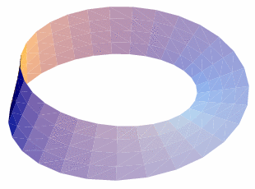
The Moebius Task

Slide 194
Defines a Manifold Task
boundary
boundary
boundary

Slide 195
Manifold Task
boundary
boundary
Note Sperner coloring on boundary
boundary

Slide 196
Terminology
Each face has a central simplex
1-dim
2-dim

Slide 197
Subdivided Faces
internal
internal
external

Slide 198
Black-and-White Coloring (I)
Central 2-simplex:
Black elsewhere
White near external face

Slide 199
Black-and-White Coloring (II)
Central simplex
of external face:
Black

Slide 200
Black-and-White Coloring (III)
All others
White

Slide 201
Moebius Solves WSB

Slide 202
Moebius Solves WSB
Every n-simplex has both black & white colors.
Boundary coloring is symmetric!

Slide 203
Higher Dimension
Moebius task generalizes to even dimensions …
Odd dimensions? Unknown.
Distributed Computing Through Combinatorial Topology

Slide 204
Progress
Weak Symmetry-Breaking
yes
Moebius Task
no
Set Agreement

Slide 205
Next Step
Weak Symmetry-Breaking
yes
Moebius Task
no
Anonymous Set Agreement

Slide 206
Lemma
Any set agreement protocol can be made anonymous
Have processes choose new names using only order and equality comparsions on old names …

Slide 207
Set Agreement ⇒ WSB
· n+1
Choose name with anonymous
n-Set agreement
Write name
Read names
My name
written?
yes
Group 0
no
Group 1

Slide 208
Set Agreement ⇒ WSB
· n+1
Choose name with anonymous
n-Set agreement
Write name
Proof
Read names
If all n+1 participate …
My name
written?
yes
First name written joins Group 0
Group 0
Some name not chosen, it joins Group 1
no
Group 1

Slide 209
Set Agreement ⇒ WSB
· n+1
Choose name with anonymous
n-Set agreement
Write name
Proof
Read names
Protocol is anonymous …
My name
written?
yes
Because we use anonymous set agreement “black box”
Group 0
no
Group 1

Slide 210
Conclusions
Some tasks harder than others …
n-set agreement solves weak-symmetry breaking
But not vice-versa
Distributed Computing Through Combinatorial Topology

Slide 211
Remarks
Combinatorial and algorithmic arguments complement one another
Combinatorial: what we can’t do
Algorithmic: what we can do
Distributed Computing Through Combinatorial Topology

